Slide 10
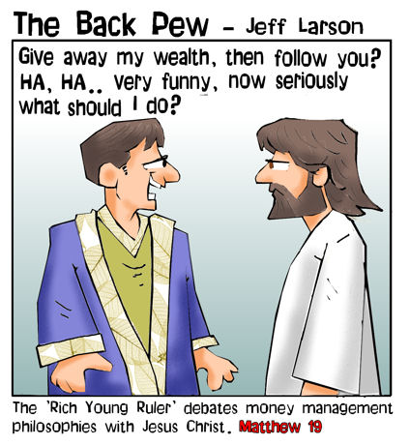

Slide 11
Do you get it?
What’s it worth?

