Slide 1
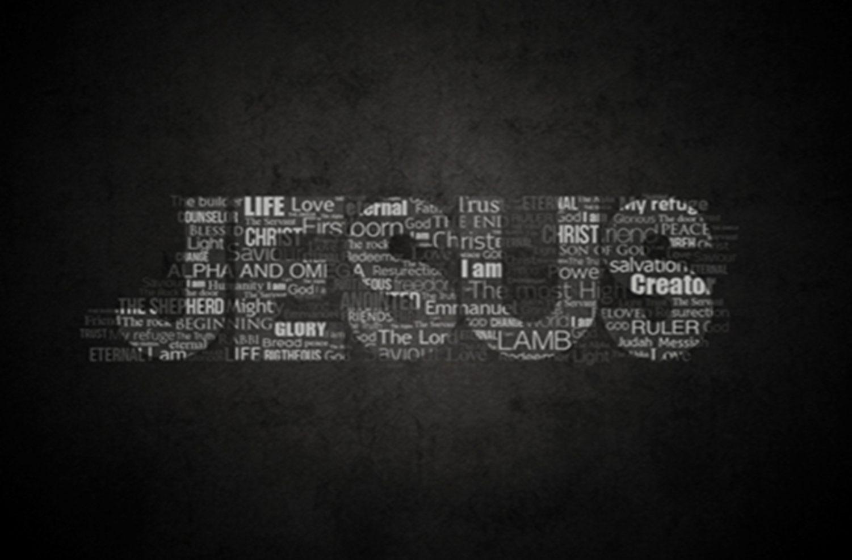
The Miracles of
In Matthew’s Gospel
The Demon Possessed Man
Matthew 12:22-38

Slide 2
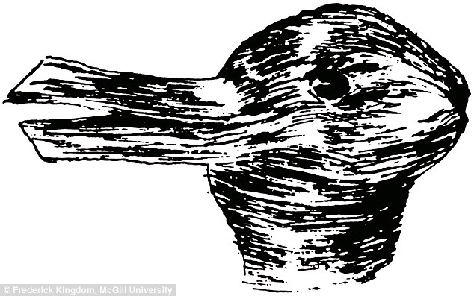

Slide 4
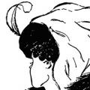

Slide 6
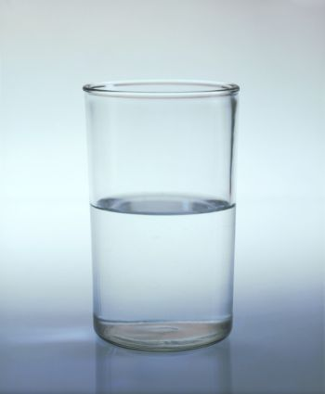

Slide 7
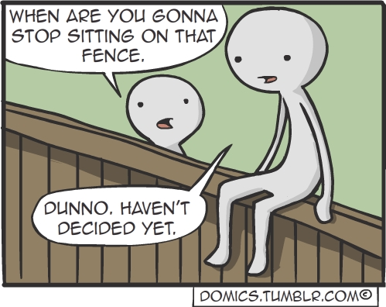

Slide 8
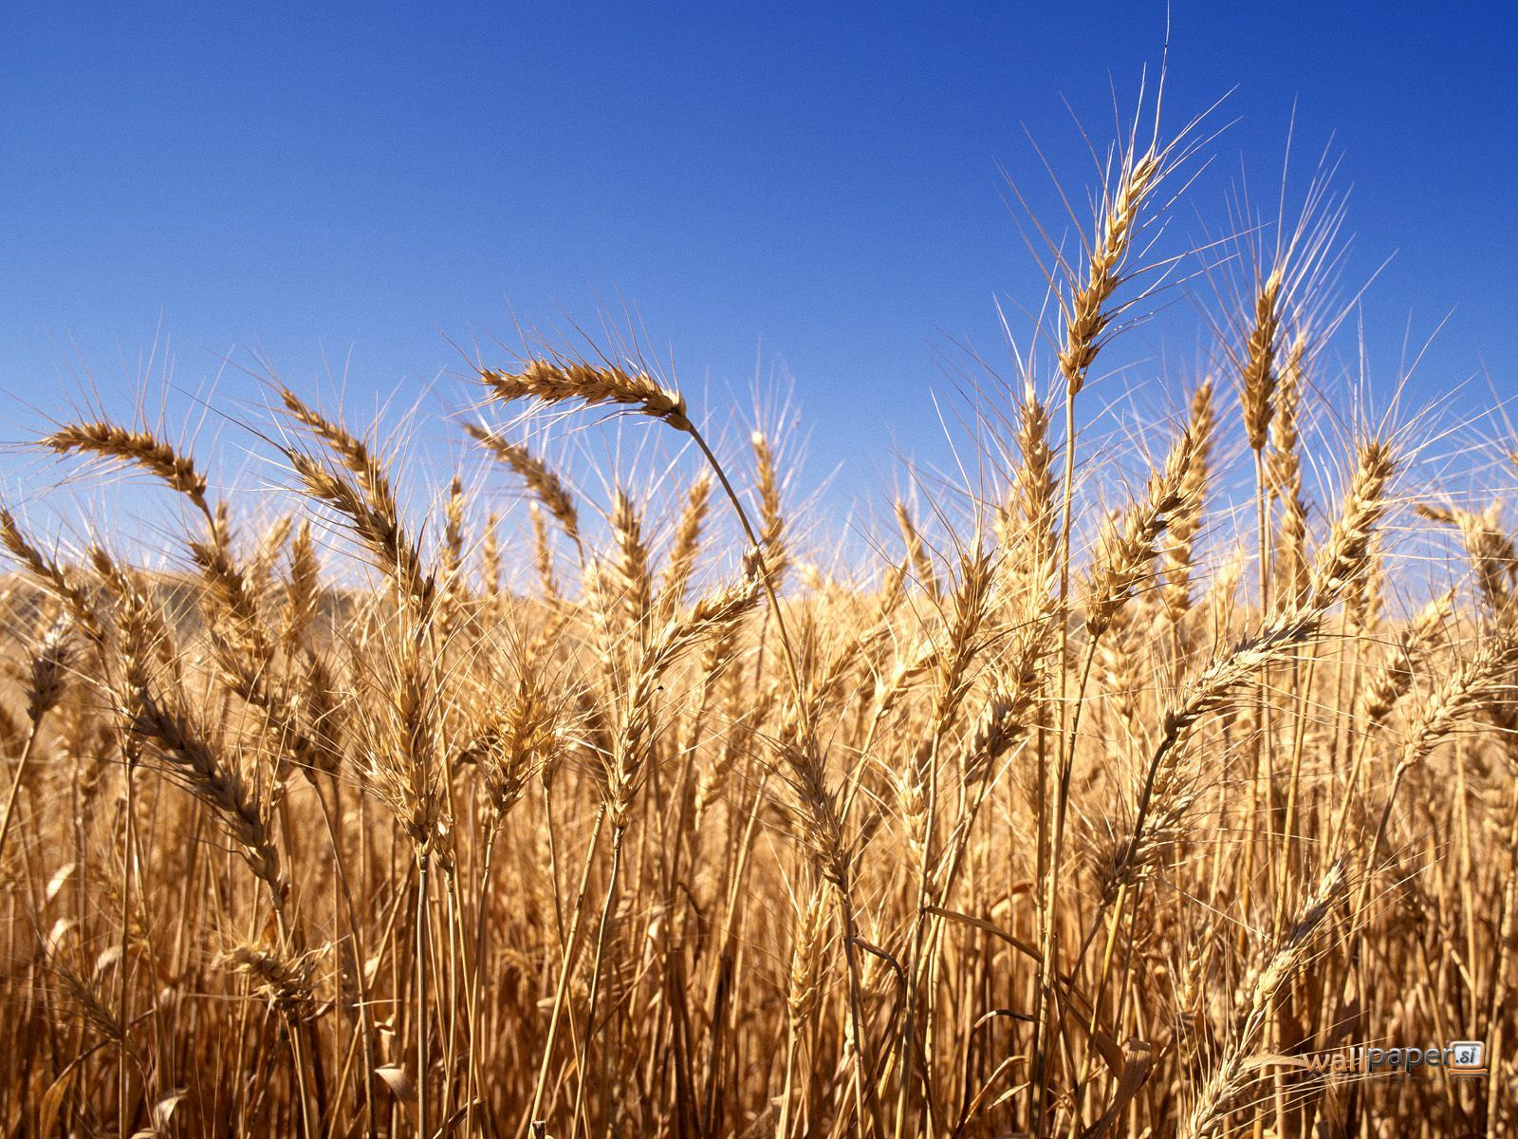

Slide 9
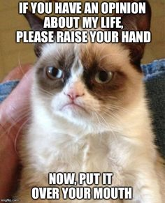

Slide 10
Who do you say Jesus is?
Importance of our words and deeds
How can we be the Kingdom people the Lord requires?

