Slide 2
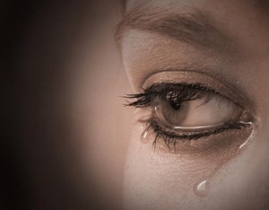

Slide 8
Let Go
&
Let God

