Slide 1
Humbly Imitating the Greatest
Philippians 2:1-11

Slide 3
John 1

Slide 4
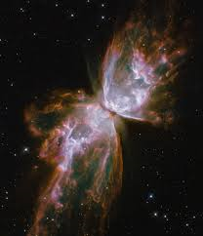
In the beginning was the Word, and the Word was with God, and the Word was God.

Slide 5
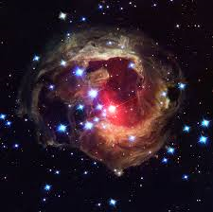
He was with God in the beginning

Slide 6
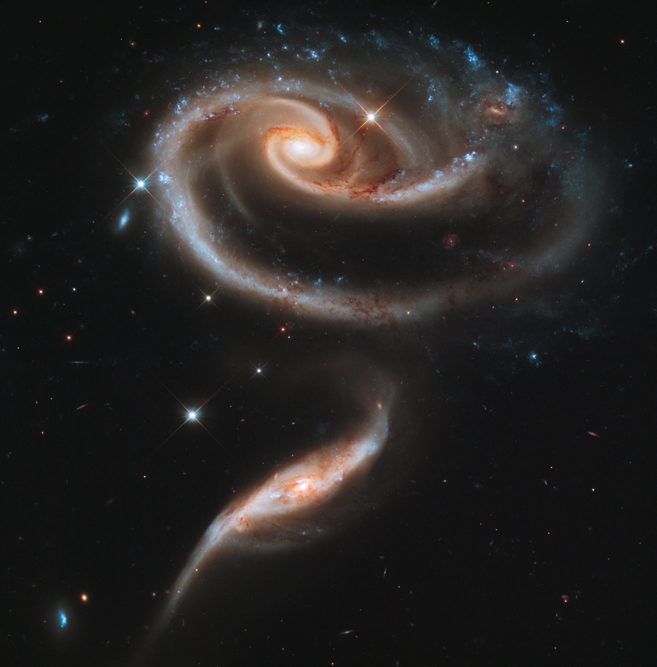
Through him all things were made; without him nothing was made that has been made

Slide 7
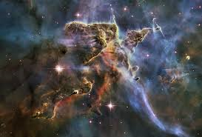
In him was life, and that life was the light of all mankind.

Slide 8
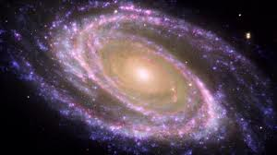
The light shines in the darkness, and the darkness has not overcome it

Slide 9
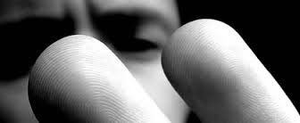
There was a man sent from God whose name was John

Slide 10
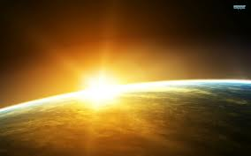
He came as a witness to testify concerning that light, so that through him all might believe

Slide 11
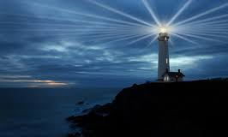
He himself was not the light; he came only as a witness to the light

Slide 12
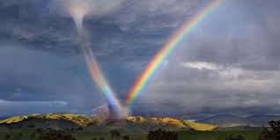
The true light that gives light to everyone was coming into the world

Slide 13
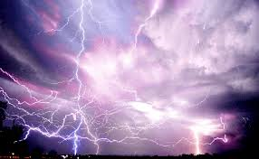
He was in the world, and though the world was made through him, the world did not recognize him

Slide 14
He came to that which was his own, but his own did not receive him

Slide 15
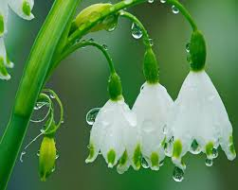
Yet to all who did receive him, to those who believed in his name, he gave the right to become children of God—

Slide 16
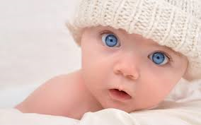
children born not of natural descent, nor of human decision or a husband’s will, but born of God

Slide 17
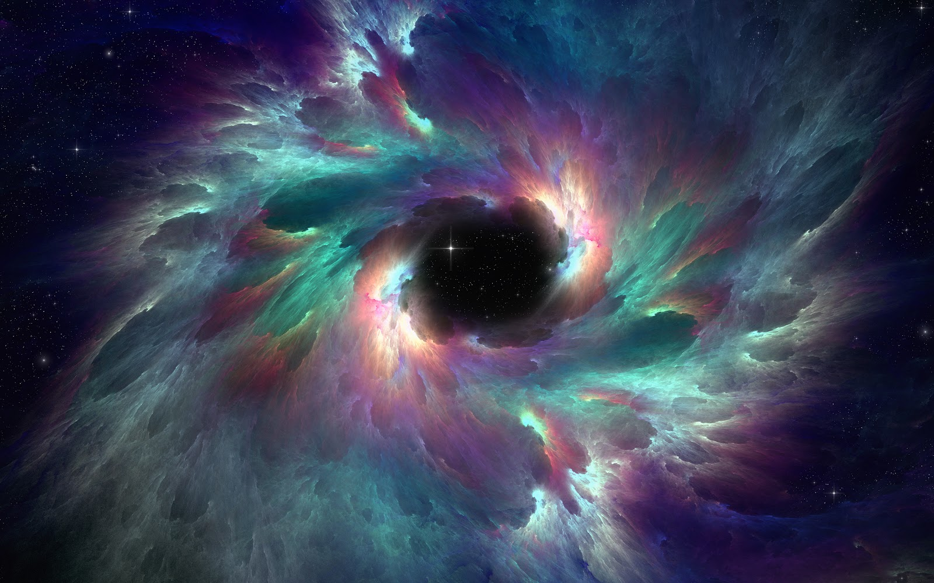
The Word became flesh and made his dwelling among us. We have seen his glory, the glory of the one and only Son, who came from the Father, full of grace and truth

Slide 18
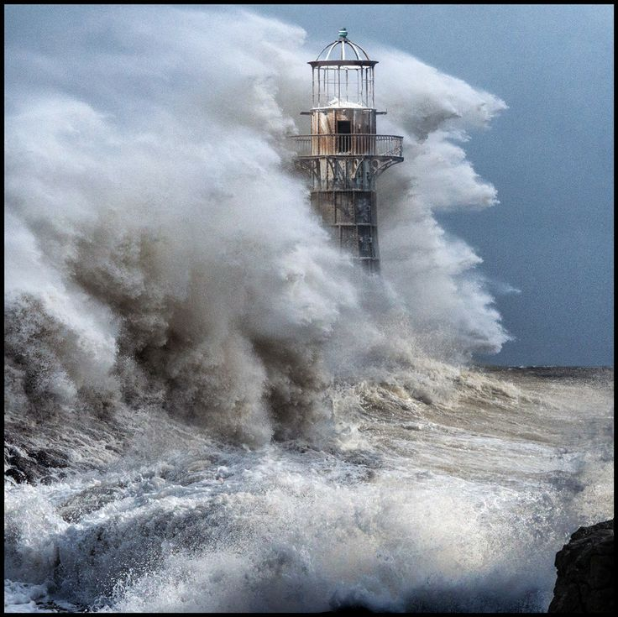

Slide 19
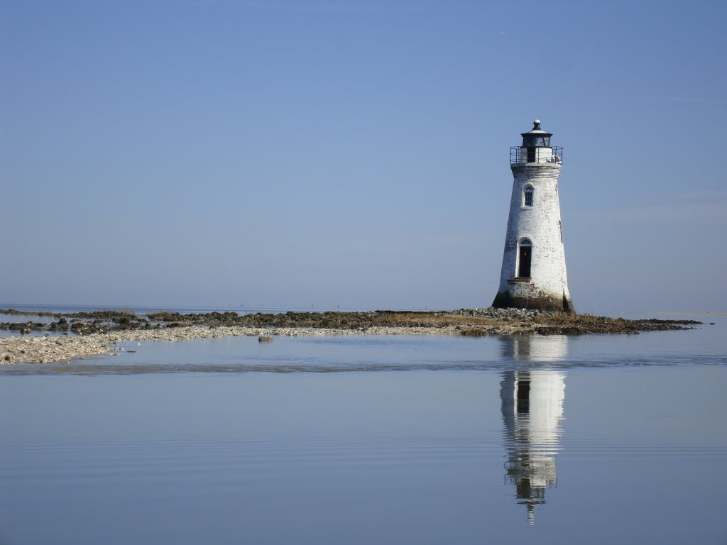

Slide 20
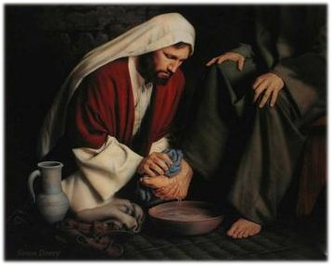

Slide 21
Take encouragement from being united with Christ Value others above yourself
Jesus was and is God
Jesus was humble
He served others
He obeyed God
We should be humble
Serve others
Obey God

