Slide 1

Adultery and Divorce
Versus
Marriage and honour

Slide 2


Slide 3
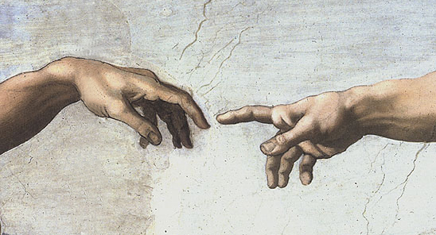

Slide 4
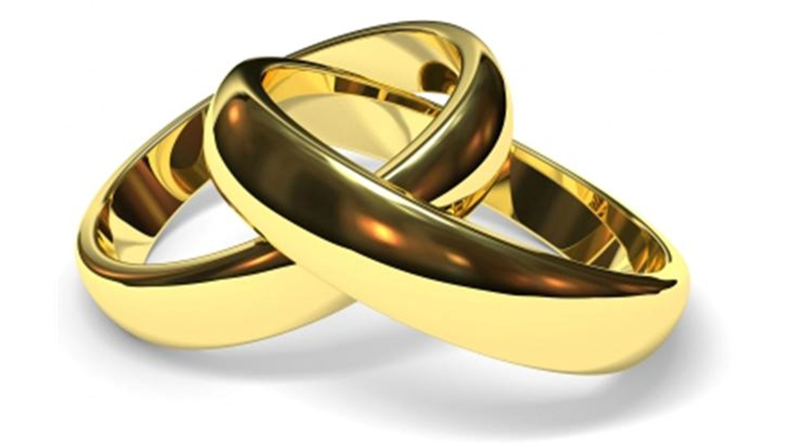

Slide 5
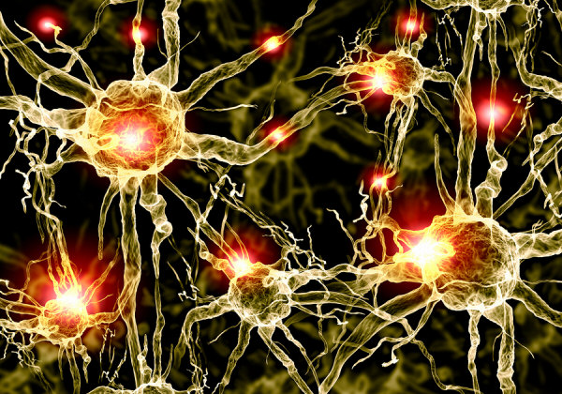

Slide 6
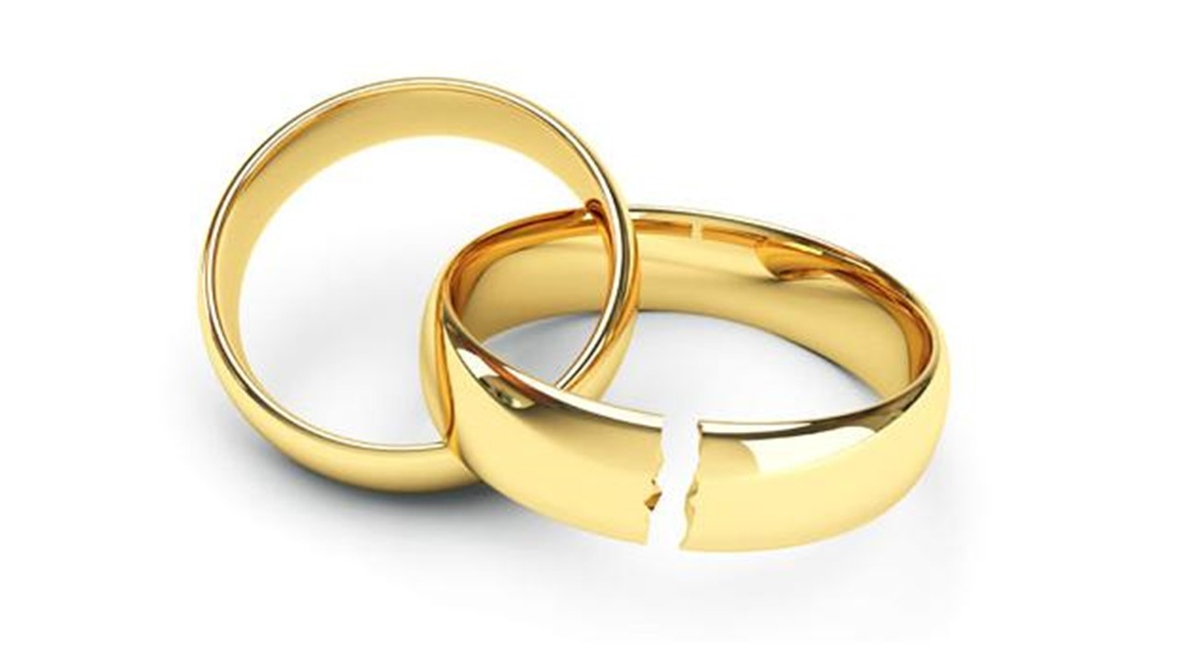

Slide 7
