Slide 8
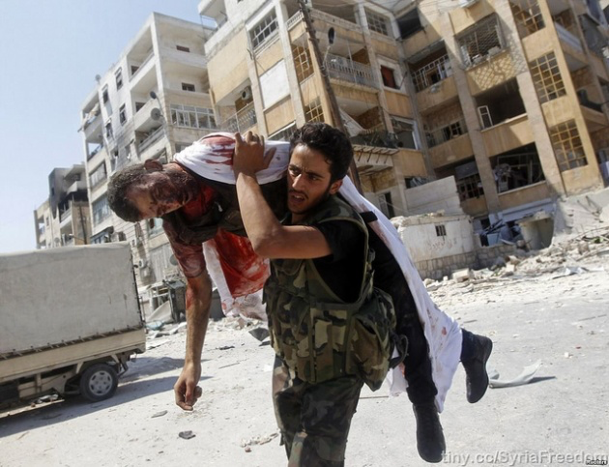

Slide 13
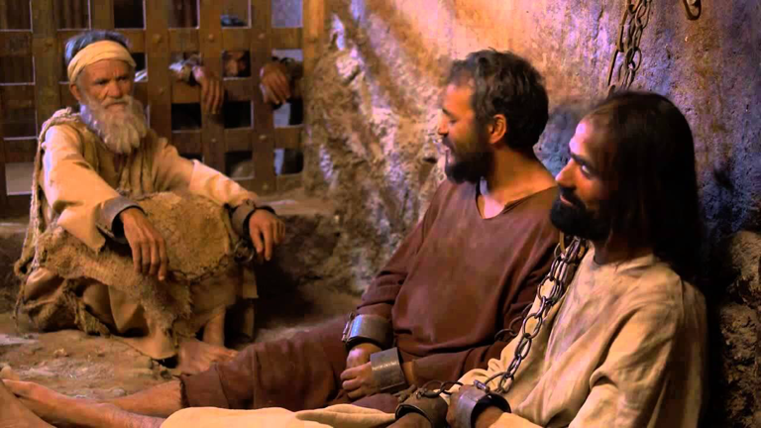

Slide 14
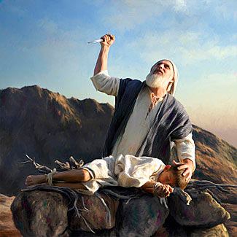

Slide 15
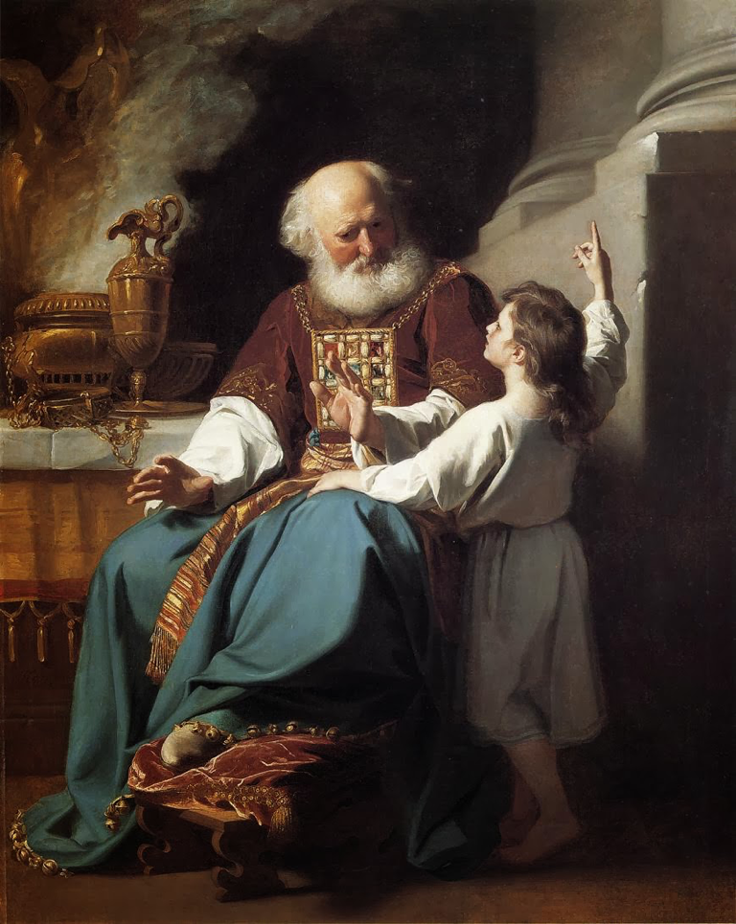

Slide 18
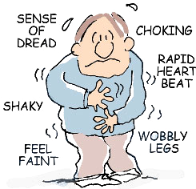
DO NOT FOCUS ON YOUR SITUATION

Slide 20
FOCUS ON
WHO YOU
ARE

