Slide 1
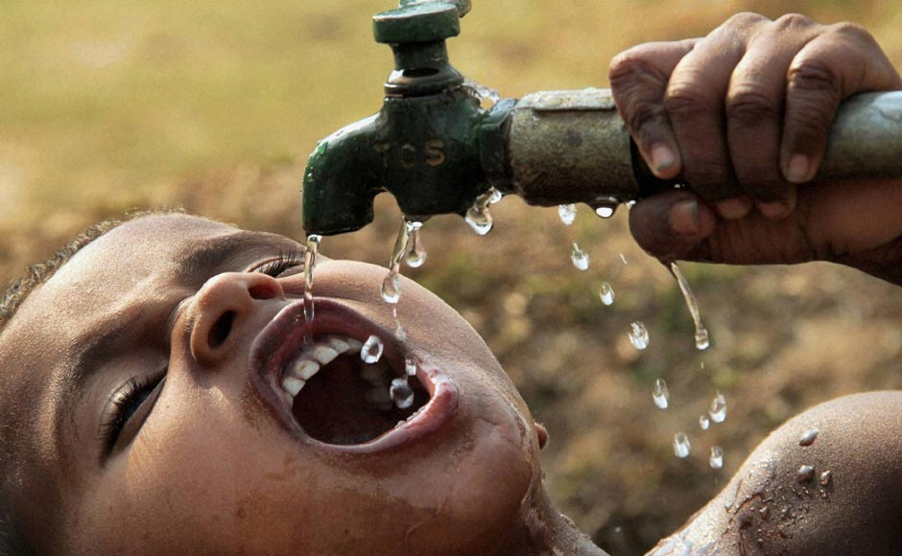
Where can I get this living water? John 4:1-26

