Slide 1
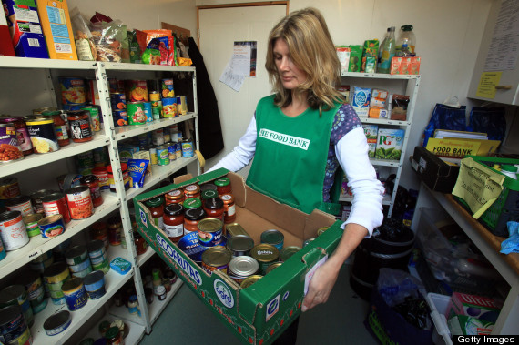

Slide 2
People need to know we care about them before they will care about what we know.

