Slide 1
THYATIRA – the church that was corrupted
Revelation 2 : 18 - 29

Slide 2
The 3 C 's
" Don't be Corrupted Concentrate on Christ"

Slide 4
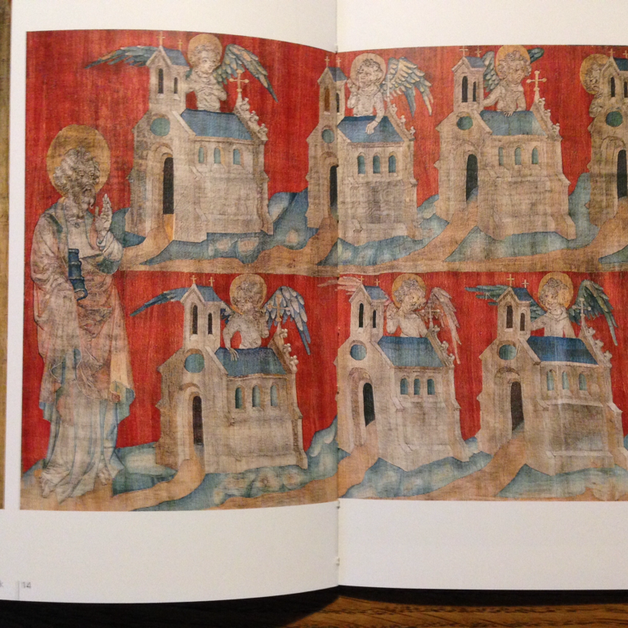

Slide 5
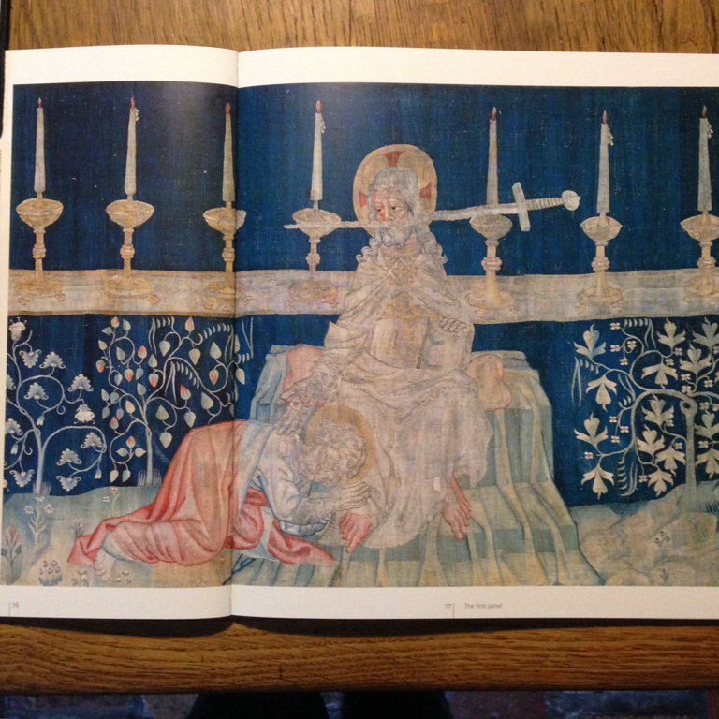

Slide 8
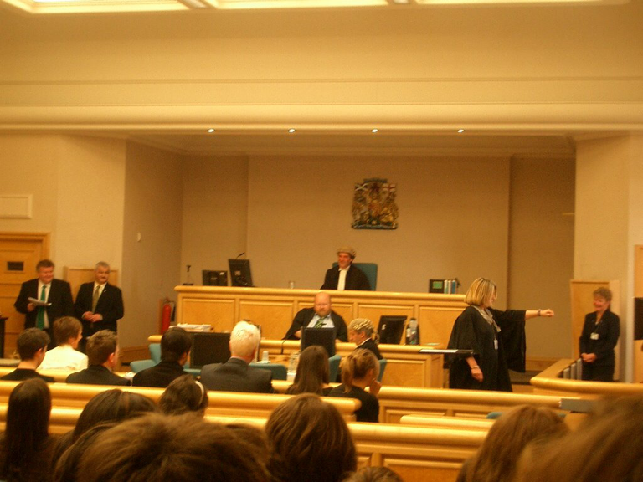

Slide 10
As individuals:
Internal desires
External sources

Slide 15
The 3 C 's
" Don't be Corrupted Concentrate on Christ"

Slide 16
The Church

Slide 17
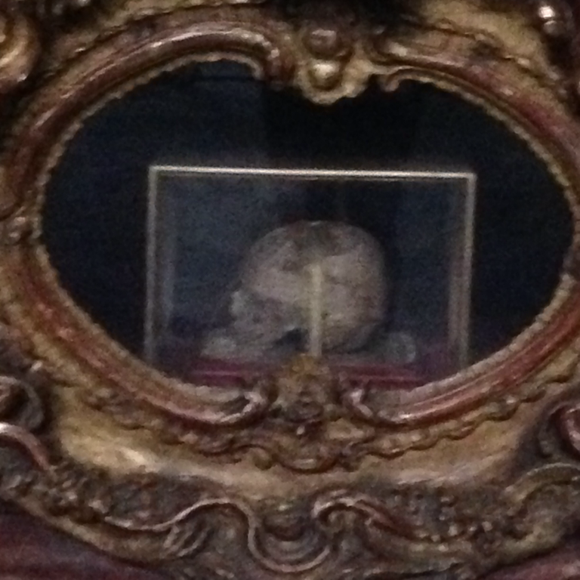

Slide 18
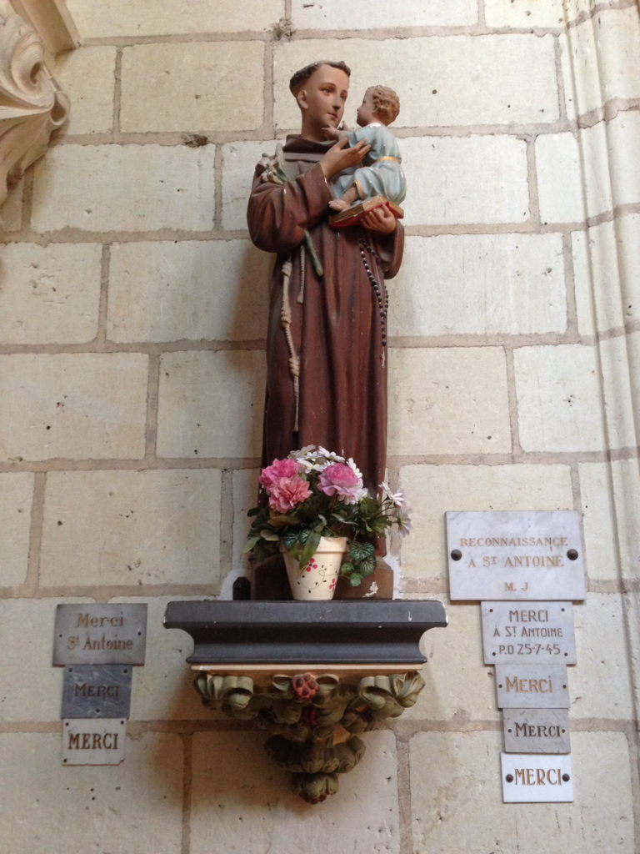

Slide 19
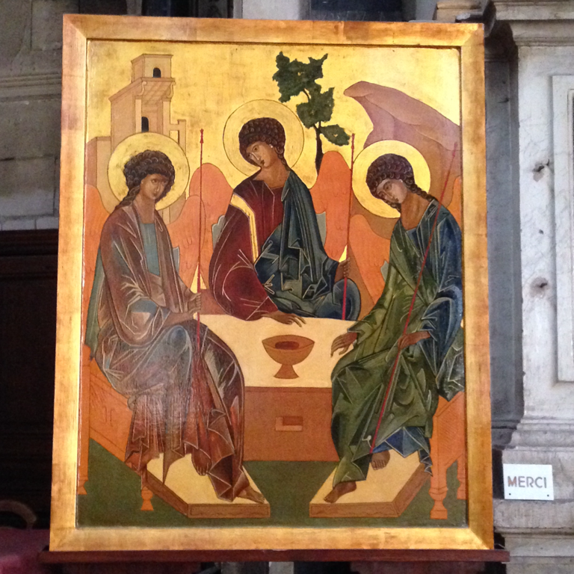

Slide 20
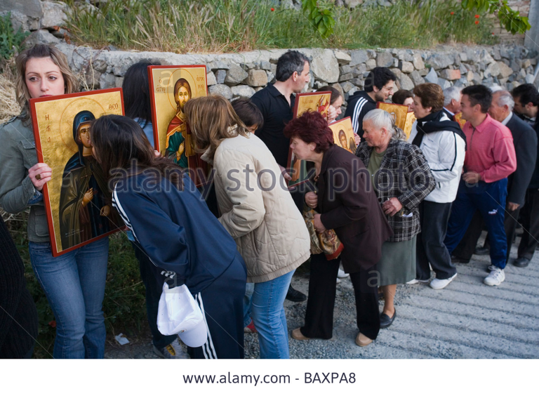

Slide 23
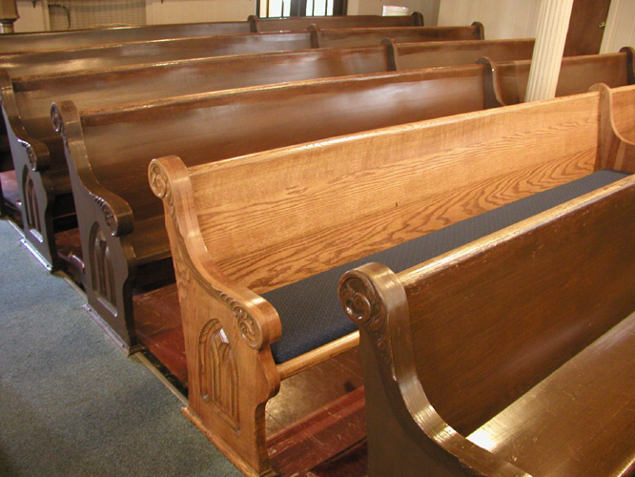

Slide 24
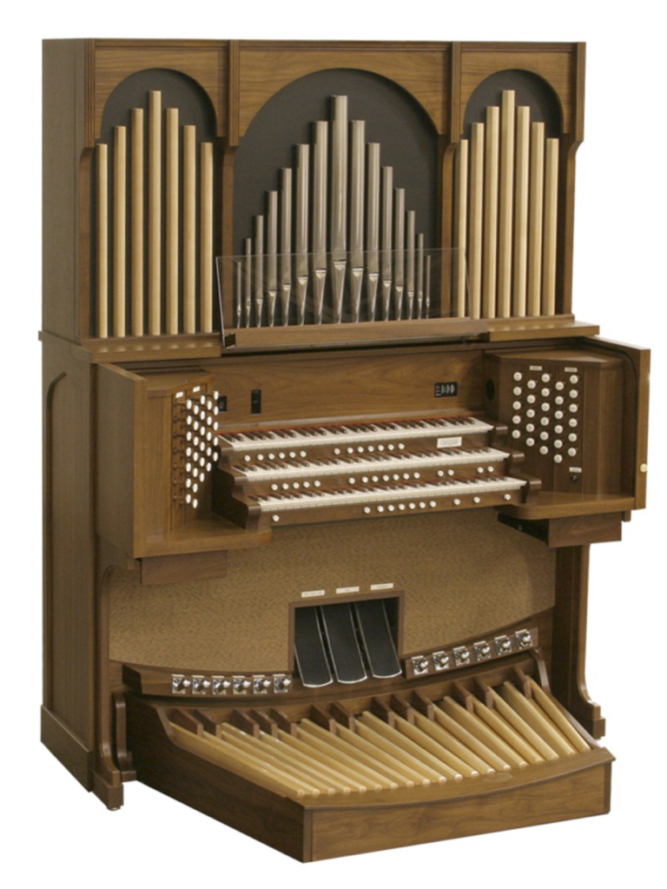

Slide 25
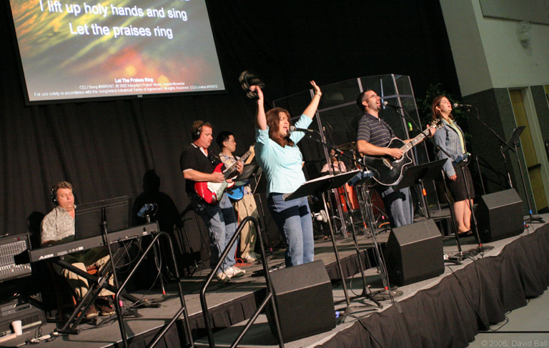

Slide 27
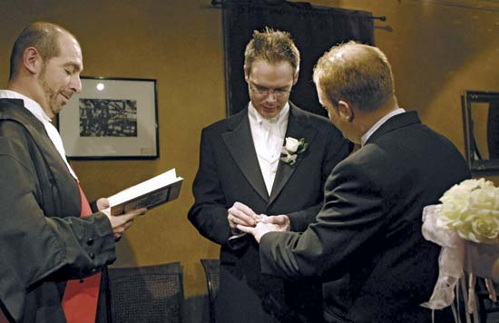

Slide 28
The 3 C 's
" Don't be Corrupted Concentrate on Christ"

