Slide 1
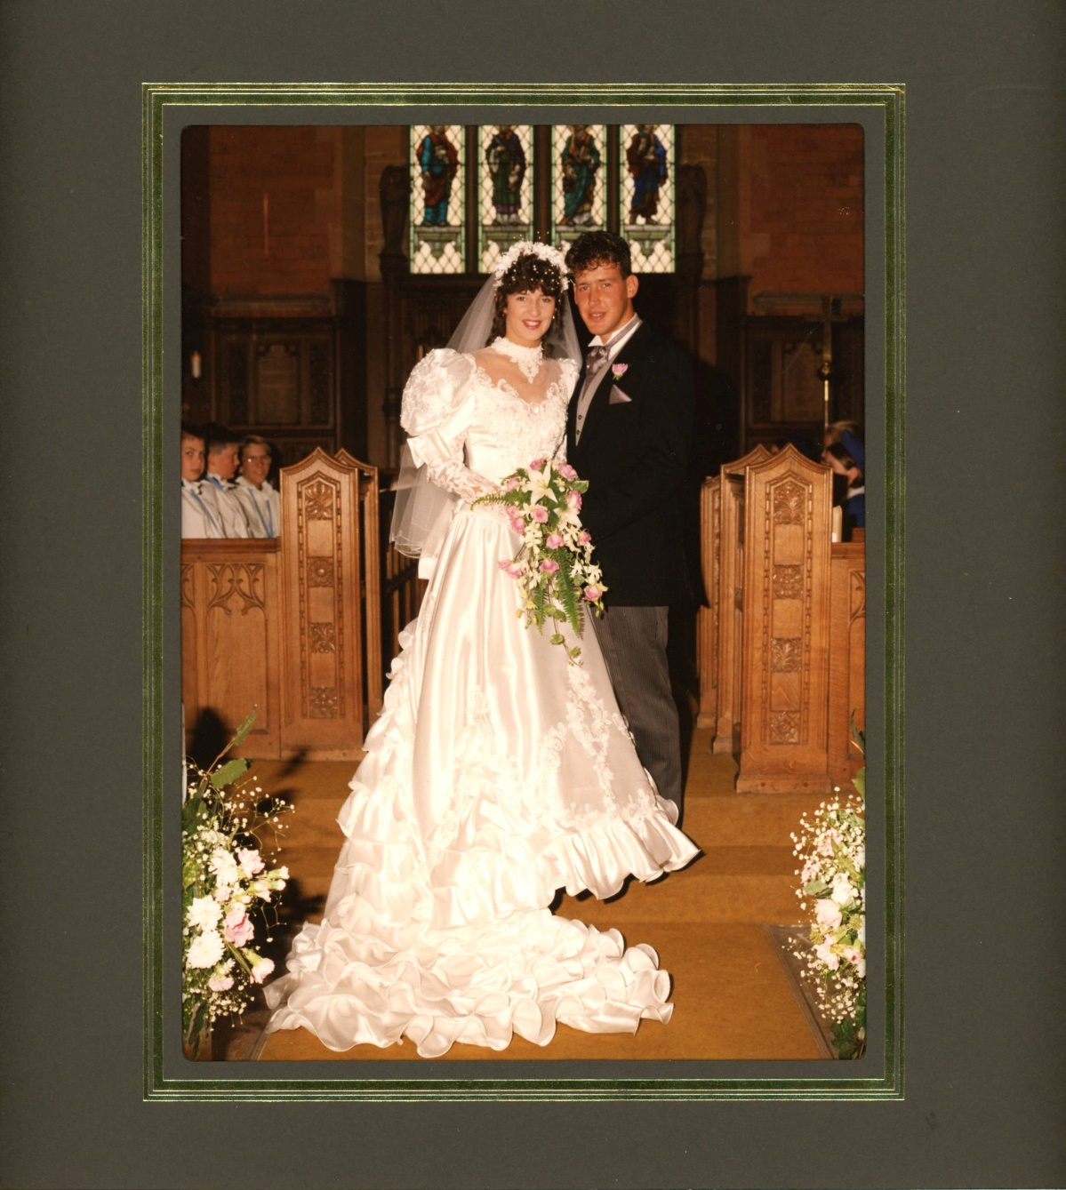

Slide 2
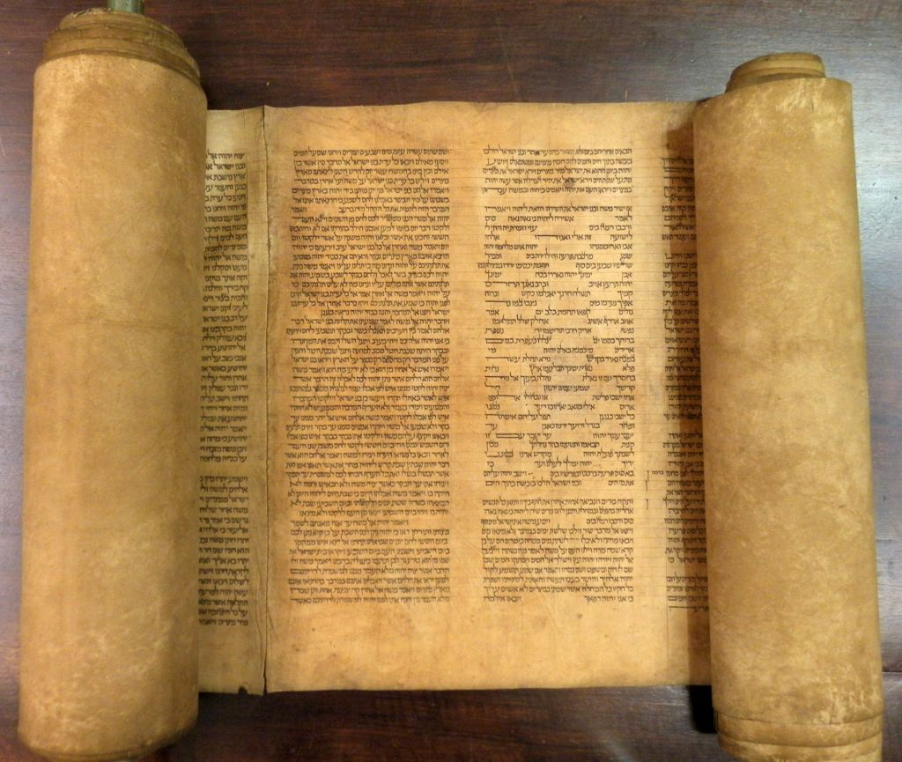

Slide 3
Therefore the Lord himself
will give you a sign;
the virgin will conceive
and give birth to a son,
and will call him Immanuel.
(Isaiah 7:14)

