Slide 3
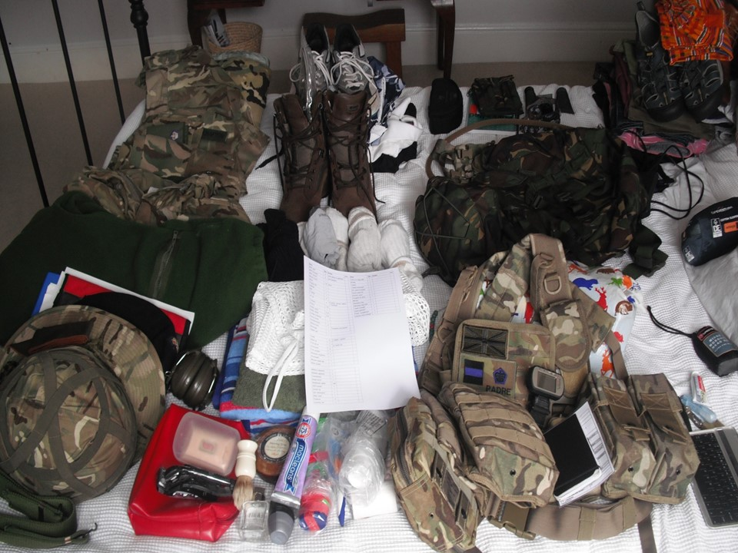

Slide 4
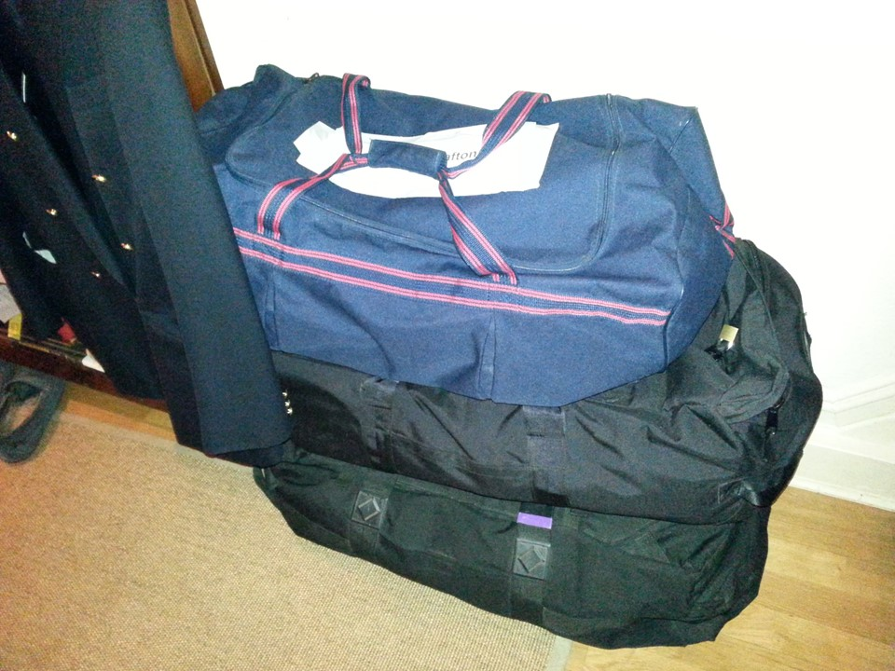

Slide 5
Slide Removed

Slide 10
