Slide 3
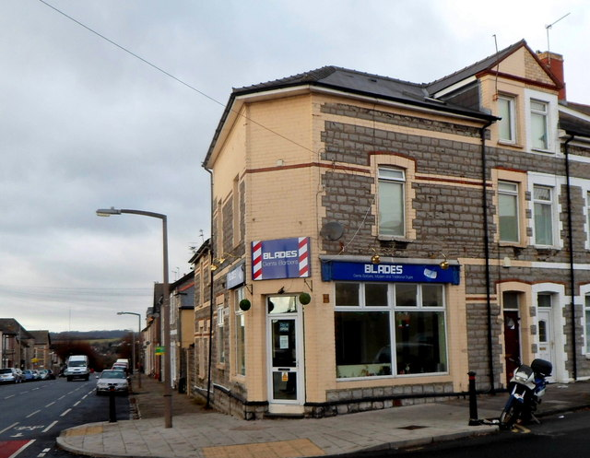

Slide 5
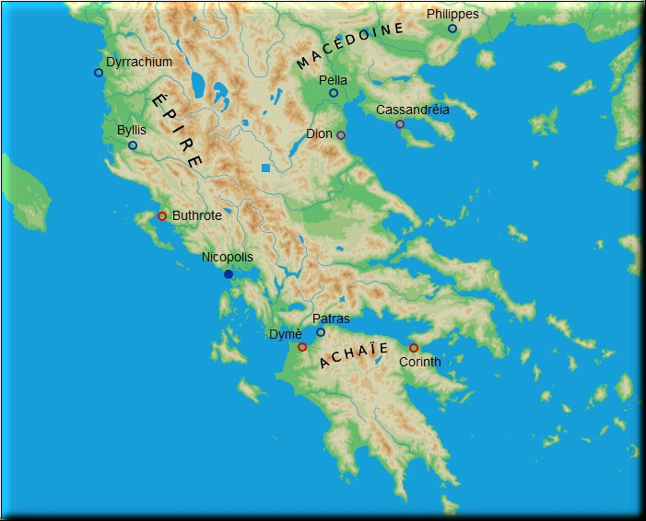

Slide 6
WHO? Paul (1:1)
WHEN? 55AD (2:12)
WHERE? Macedonia (2:13, 7:5)
WHO TO? Corinthians (1:1)

Slide 7
WHO? Paul (1:1)
WHEN? 55AD (2:12)
WHERE? Macedonia (2:13, 7:5)
WHO TO? Corinthians (1:1)
WHAT exactly did he write?
So WHAT has it got to do with us?
WHY did he write it?

Slide 8
“Was I fickle when I intended to do this? Or do I make my plans in a worldly manner so that in the same breath I say both "Yes, yes" and "No, no"?”
2 Corinthians 1:17

Slide 9
Sometimes what we think we hear is wrong…

Slide 10
Sometimes what we think we hear is wrong…
… and sometimes we hear right but do the wrong thing!

