Slide 1
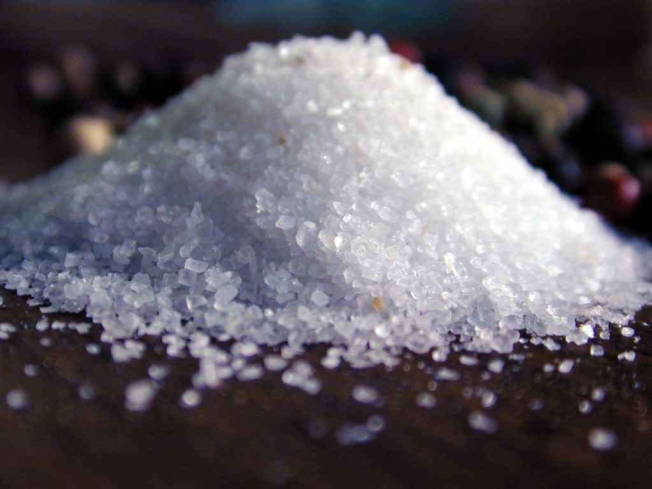
“You are the salt of the earth”
Matthew 5 v 13

Slide 2
¹¹ “Blessed are you when they revile and persecute you, and say all kinds of evil against you falsely for My sake. ¹² Rejoice and be exceedingly glad, for great is your reward in heaven, for so they persecuted the prophets who were before
¹³ “You are the salt of the earth; but if the salt loses its flavor,
how shall it be seasoned? It is then good for nothing but to be thrown out and trampled underfoot by men.¹⁴ “You are the light of the world. A city that is set on a hill cannot be hidden. ¹⁵ Nor do they light a lamp and put it under a basket, but on a lampstand, and it gives light to all who are in the house. ¹⁶ Let your light so shine before men, that they may see your good works and glorify your Father in heaven.

Slide 3
Award-winning author Margaret Visser wrote:
"Salt is the only rock consumed directly by man. It corrodes but preserves, desiccates but is wrested from the water. It has fascinated man for thousands of years, not only as a substance he prized and was willing to labour to obtain, but also as a generator of poetic and mythic meaning. The contradictions it embodies only intensify its power and its links with the experience of the sacred."

Slide 4
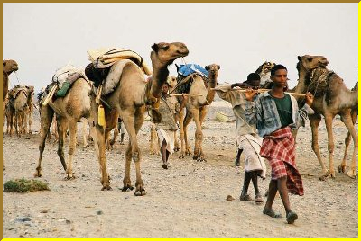
Trading caravan on a Salt Road

Slide 5
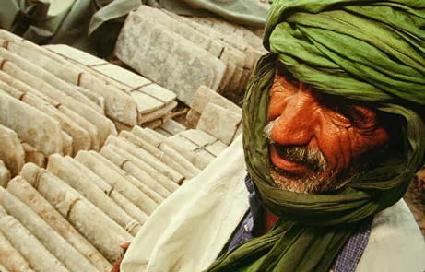
Salt Trader

Slide 6
Salt was VALUABLE
Matthew 5 v 13

Slide 7
Salt was VALUABLE
and USEFUL
Matthew 5 v 13

Slide 8
5 And seeing the multitudes, He went up on a mountain, and when He was seated His disciples came to Him. ² Then He opened His mouth and taught them, saying:
³ “Blessed are the poor in spirit, For theirs is the kingdom of heaven.
⁴ Blessed are those who mourn, For they shall be comforted.
⁵ Blessed are the meek, For they shall inherit the earth.
⁶ Blessed are those who hunger and thirst for righteousness,
For they shall be filled.
⁷ Blessed are the merciful, For they shall obtain mercy.
⁸ Blessed are the pure in heart, For they shall see God.
⁹ Blessed are the peacemakers, For they shall be called sons of God.
¹⁰ Blessed are those who are persecuted for righteousness’ sake,
For theirs is the kingdom of heaven.

Slide 9
¹¹ “Blessed are you when they revile and persecute you, and say all kinds of evil against you falsely for My sake. ¹² Rejoice and be exceedingly glad, for great is your reward in heaven, for so they persecuted the prophets who were before
¹³ “You are the salt of the earth; but if the salt loses its flavor, how shall it be seasoned? It is then good for nothing but to be thrown out and trampled underfoot by men.¹⁴ “You are the light of the world. A city that is set on a hill cannot be hidden. ¹⁵ Nor do they light a lamp and put it under a basket, but on a lampstand, and it gives light to all who are in the house. ¹⁶ Let your light so shine before men, that they may see your good works and glorify your Father in heaven.

Slide 10
“You are the salt of the earth”
Matthew 5 v 13

