Slide 1
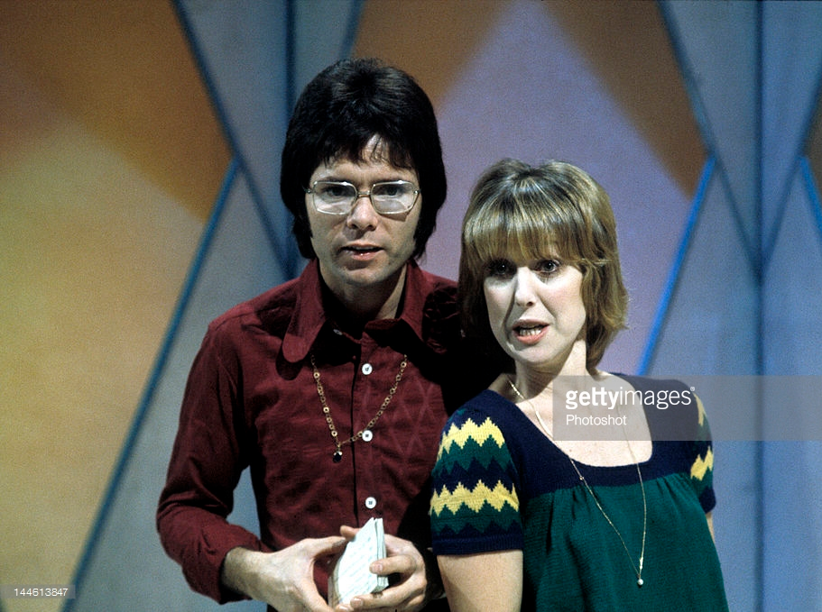

Slide 2
“It’s comforting to know that in these days of galloping inflation, the wages of sin remain exactly the same…
DEATH”
Romans3:23
“It’s comforting to know that in these days of galloping inflation, the wages of sin remain exactly the same…
DEATH”
Romans3:23

Slide 3
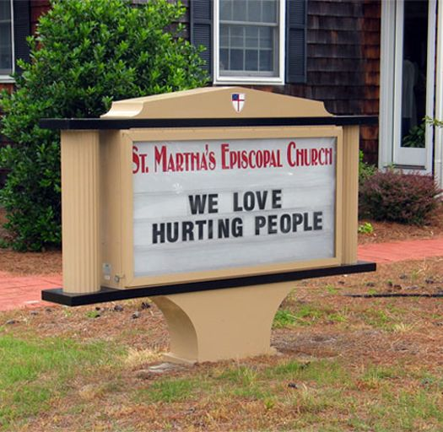

Slide 4
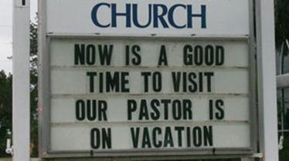

Slide 5
If.?
. .?
What if the Bible is right?
Find out more on Sunday mornings at 10.30am

Slide 6
We don’t need to be told what is wrong IF we know what is right
If.
..
If.
..
Paul’s Letter to the Romans
Chapter 1
Paul’s Letter to the Romans
Chapter 1

Slide 7
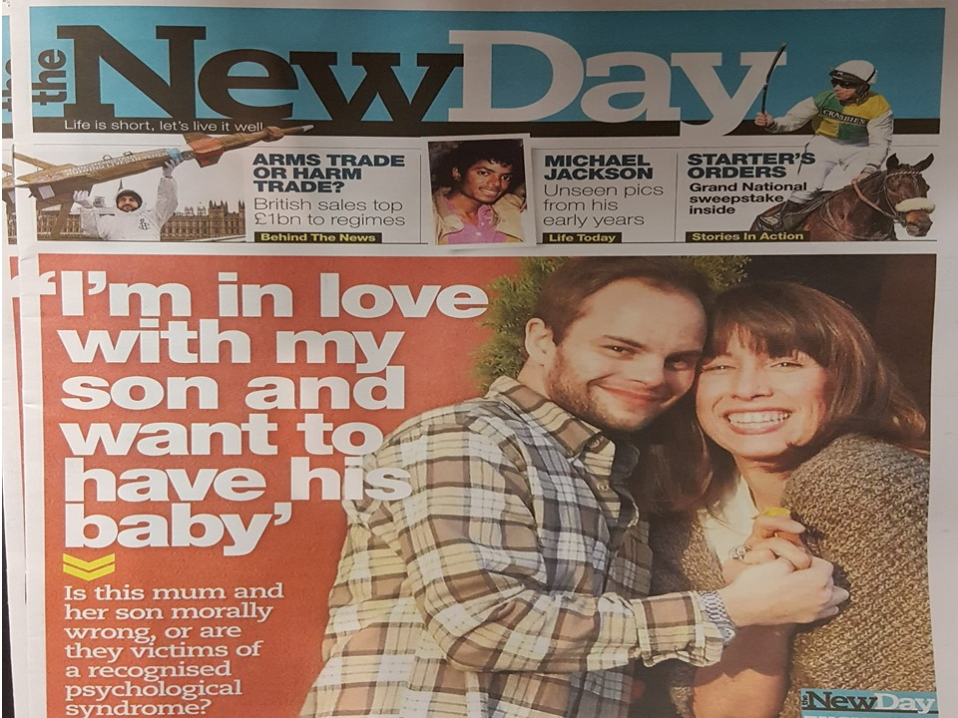

Slide 8
We can’t claim ignorance IF we know God
If.
..
If.
..
Paul’s Letter to the Romans
Chapter 1
Paul’s Letter to the Romans
Chapter 1

Slide 9
We can’t say, “It’s not fair” IF we were warned beforehand
If.
..
If.
..
Paul’s Letter to the Romans
Chapter 1
Paul’s Letter to the Romans
Chapter 1

Slide 10
We don’t need to be told what is wrong
We can’t claim ignorance
We can’t say, “It’s not fair”
If.
..
If.
..
Paul’s Letter to the Romans
Chapter 1
Paul’s Letter to the Romans
Chapter 1

