Slide 2
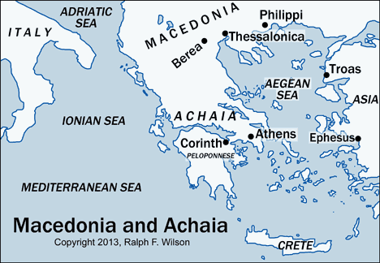

Slide 4
Thanksgiving for Faith

