Slide 2
Caleb (12) Helen (?) Esther (6) Angus (?) Charis (9)

Slide 3
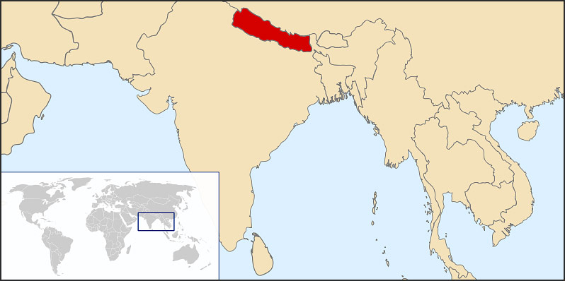
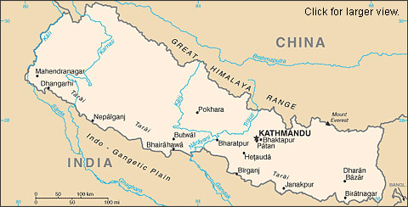

Slide 4
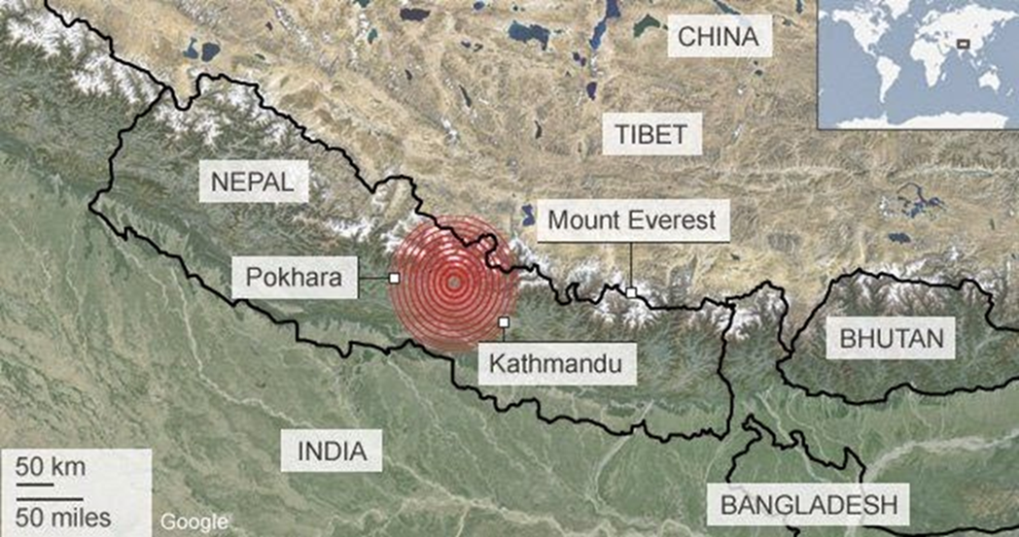
25th April 2015 7.8 Earthquake

Slide 5
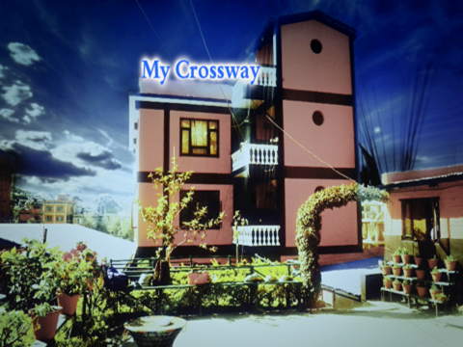
Cross-Way Community Church

Slide 6
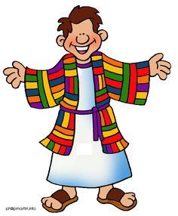
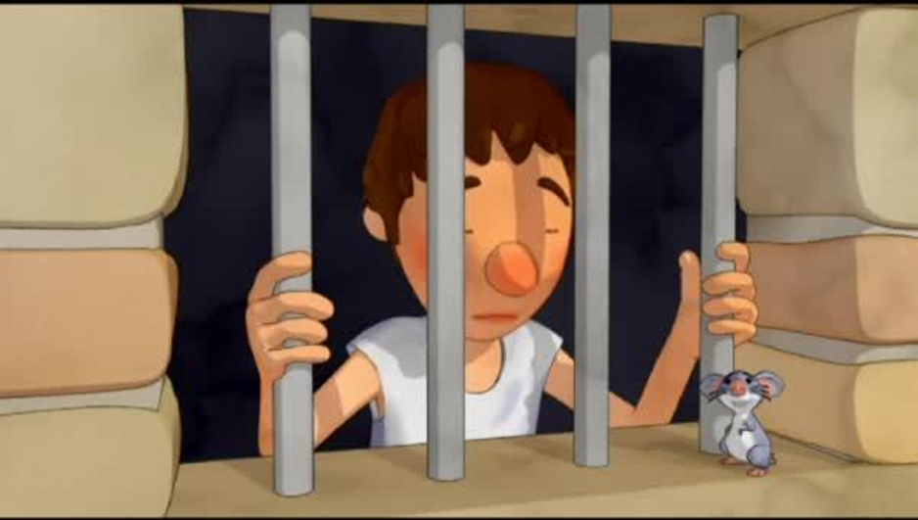
Joseph

Slide 7
Esther’s picture of the earthquake

Slide 12
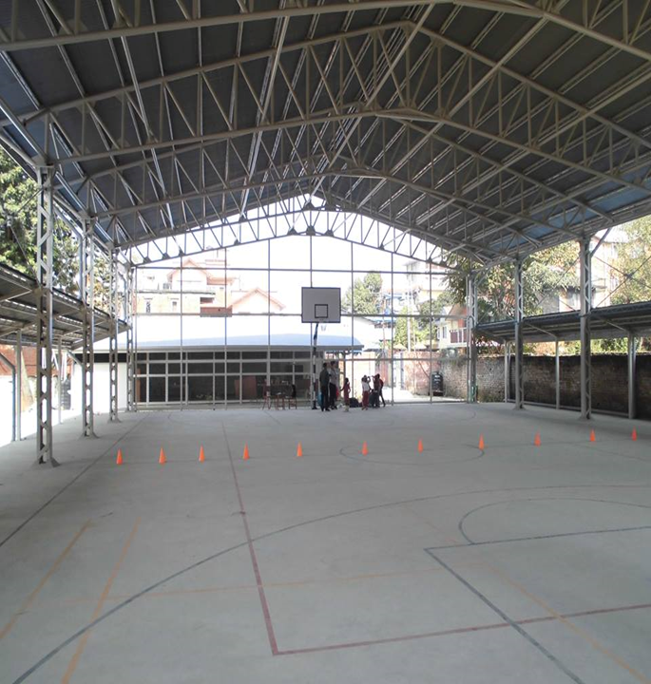
Kathmandu International Study Centre

Slide 15
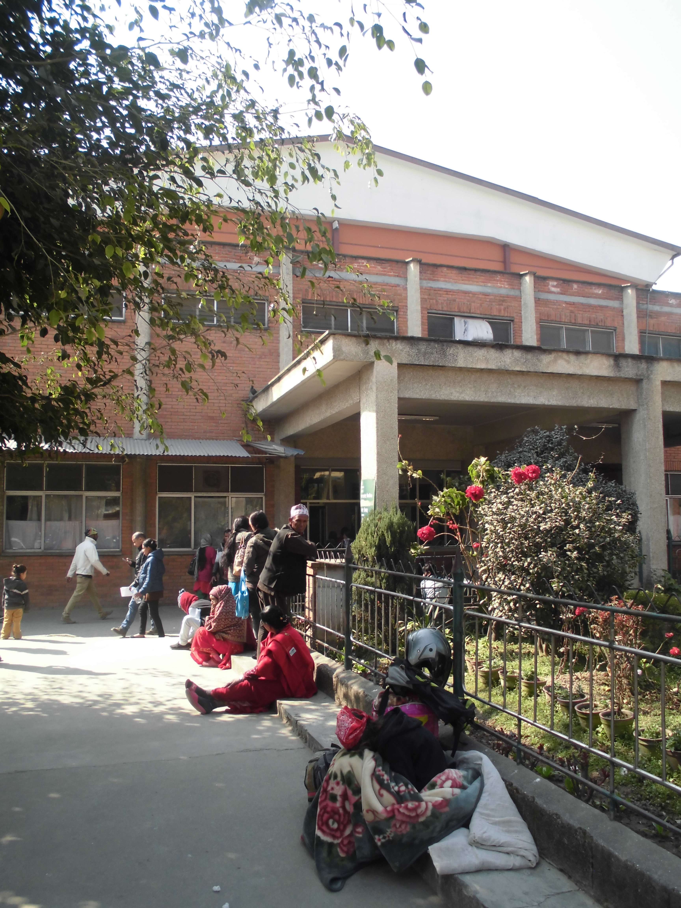
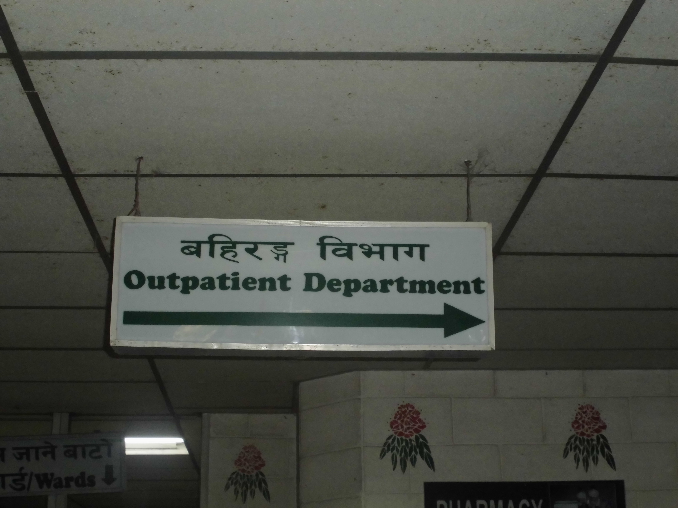
Patan Hospital

Slide 16
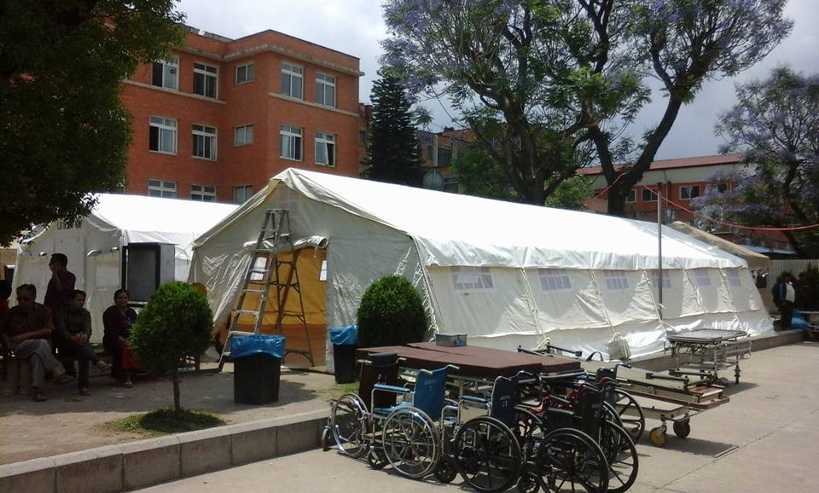
Patan Hospital

Slide 17
Temporary accommodation

Slide 18
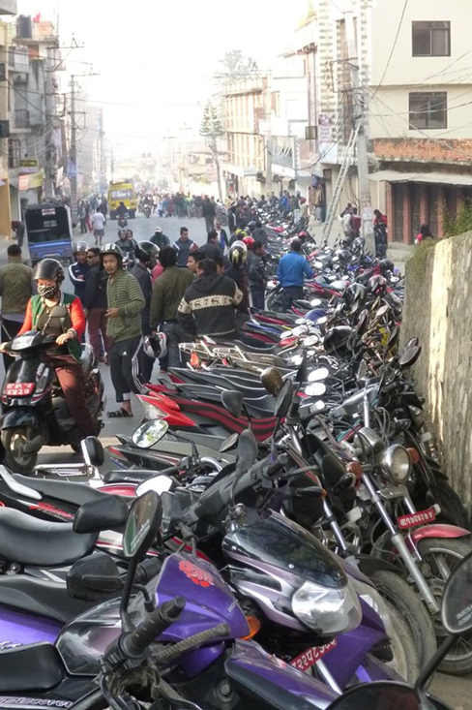
Border Blockade

Slide 19
Cooking gas queue

