Slide 2
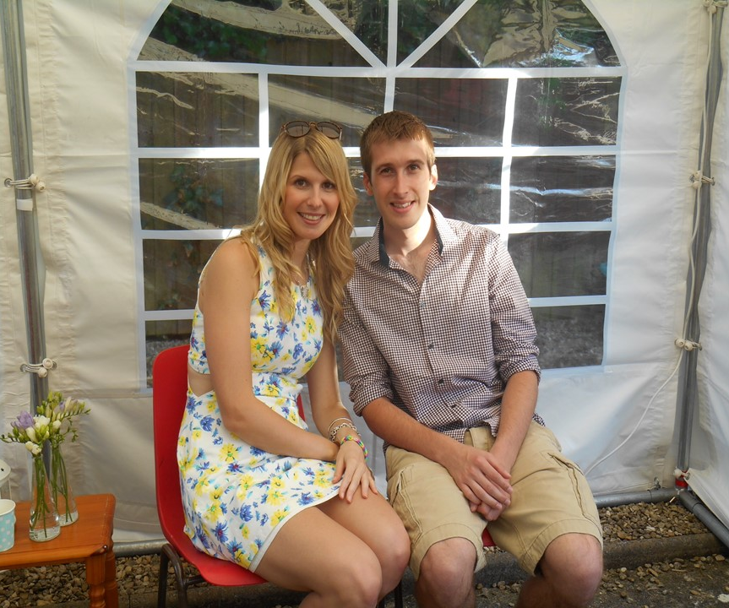

Slide 8
PLEA
PARDON
PROGRESS
PLAN AND PROMISE

Slide 9
