Slide 1
Do you believe this? John 11: 17 - 27

Slide 2
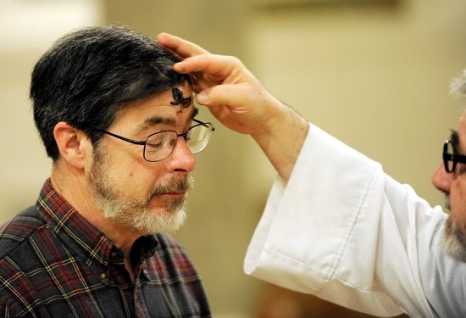

Slide 3
Do you believe this? John 11: 17 - 27
Faith that God knows best and is in control

Slide 4
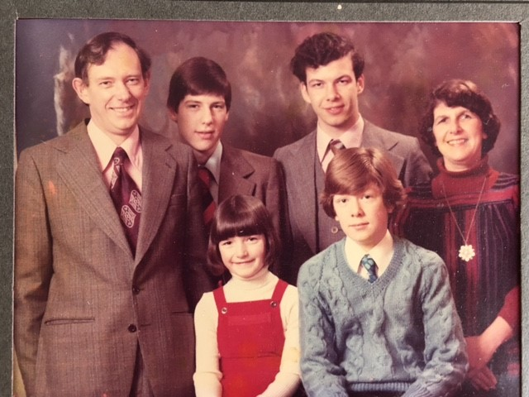

Slide 5
Do you believe this? John 11: 17 - 27
Faith that God knows best and is in control
Faith that God can do the impossible

Slide 6
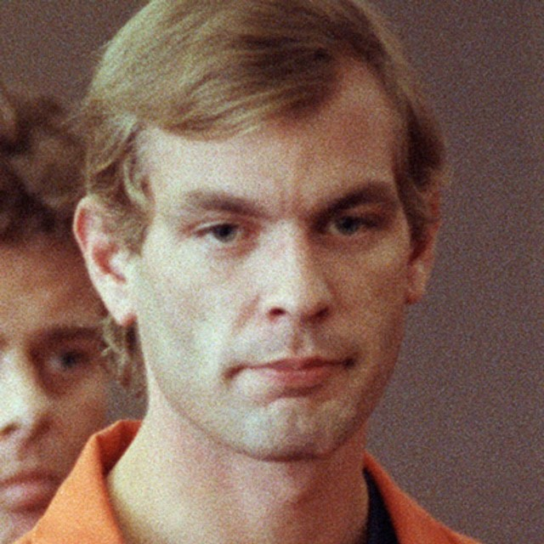

Slide 7
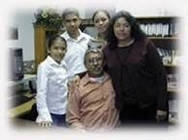
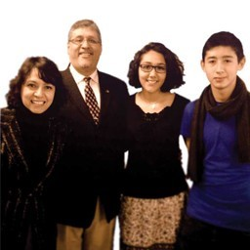

Slide 9
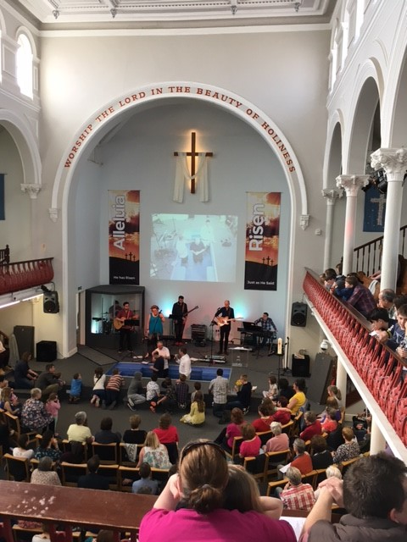

Slide 10
Do you believe this? John 11: 17 - 27
Faith that God knows best and is in control
Faith that God can do the impossible
Faith that God will keep his promises

Slide 11
Do you believe this? John 11: 17 - 27
Faith that God knows best and is in control
Faith that God can do the impossible
Faith that God will keep his promises
Faith that God will give us life

