Slide 2
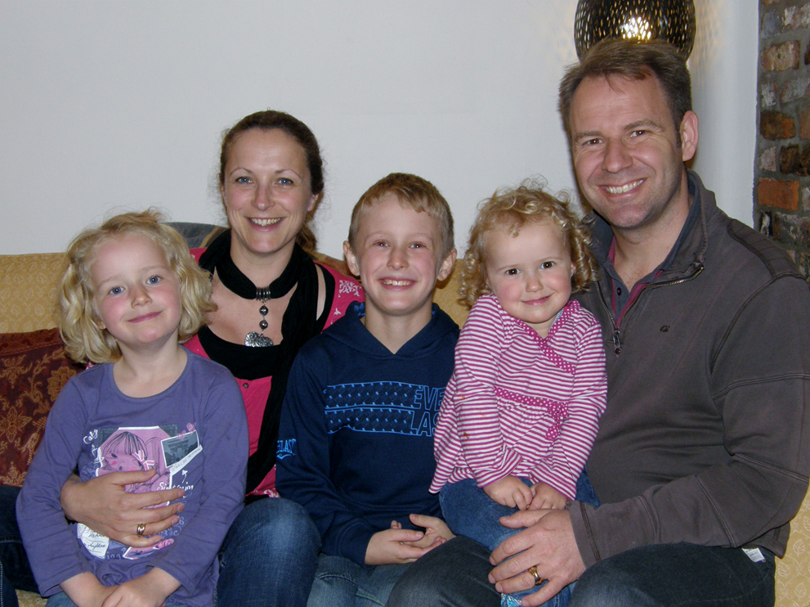

Slide 3
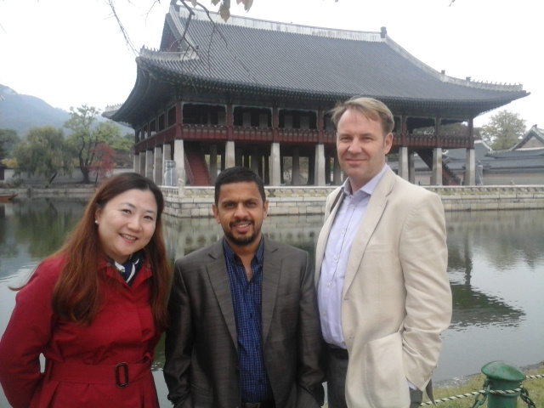
Khim Kandel
S. Korea
USA

Slide 4
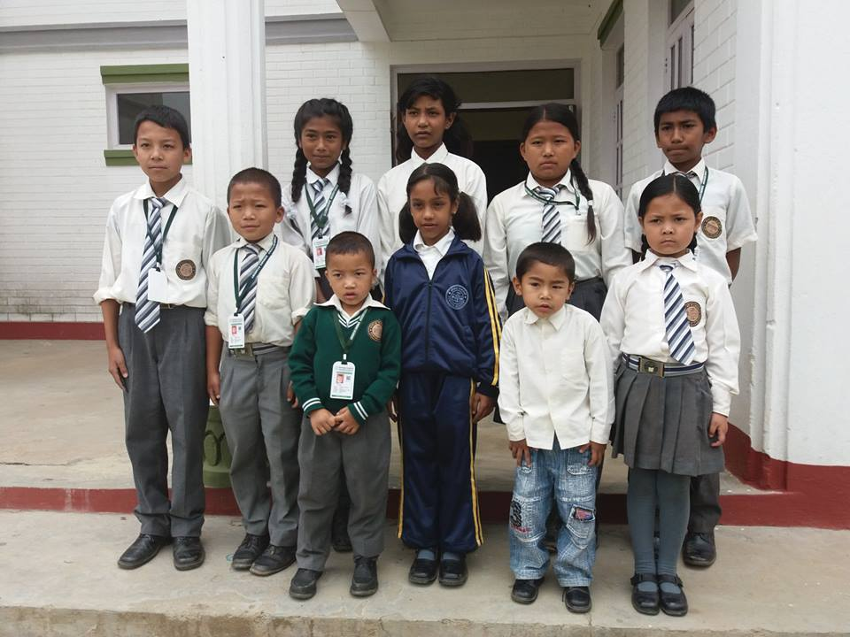
Classroom Libraries
Student Scholarships

Slide 5
Dr Tirtha Thapa

Slide 6
New KISC Site

Slide 7
Amit Bhandari

Slide 8
PAHS GP Faculty

Slide 9
Nirjala

Slide 10
Crossway’s childrens’ team

Slide 11
Holiday Club

Slide 12
