Slide 1
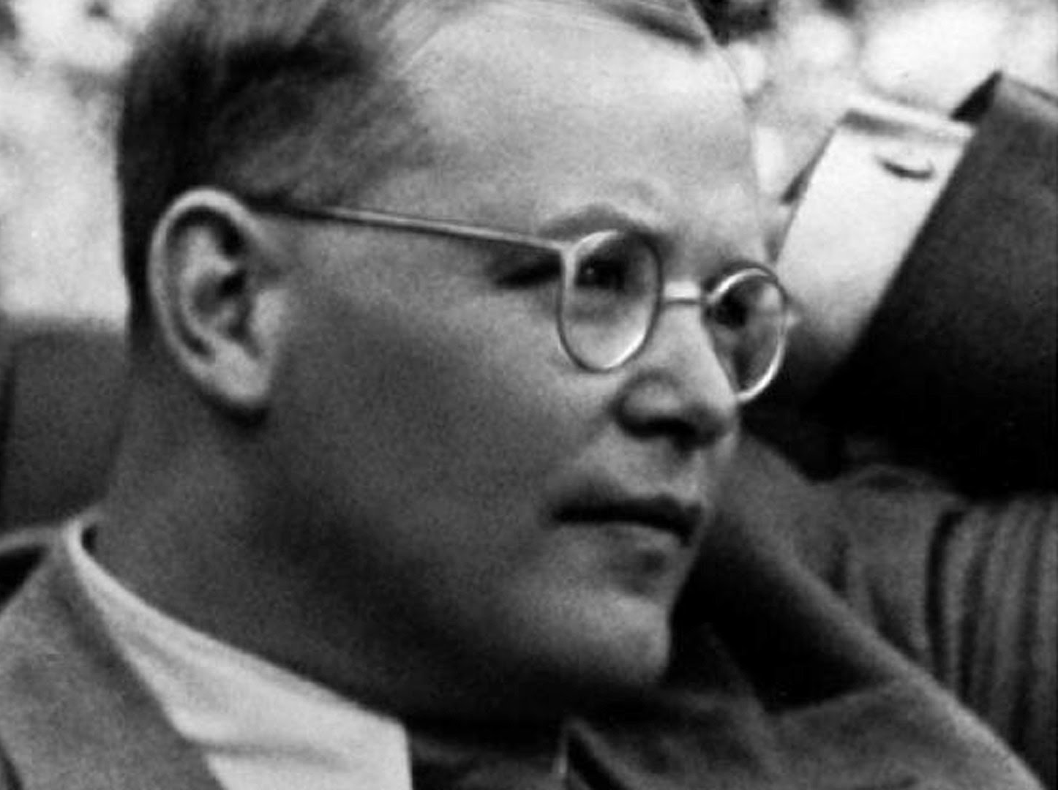
Dietrich Bonhoeffer
1906 - 1945

Slide 3
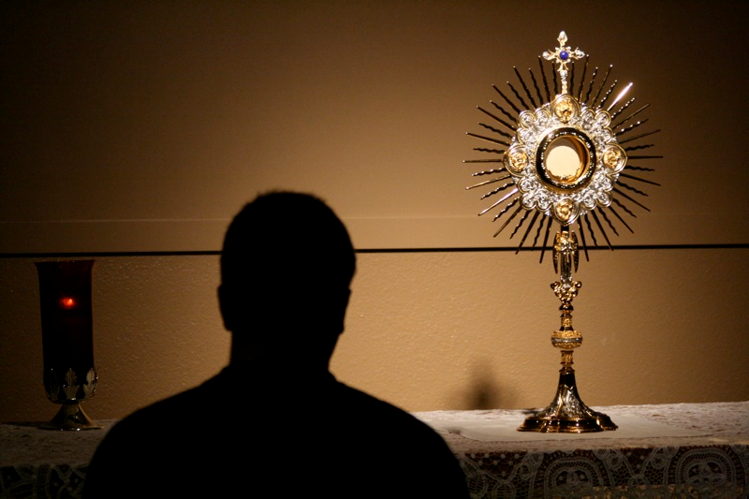

Slide 4
