Slide 1
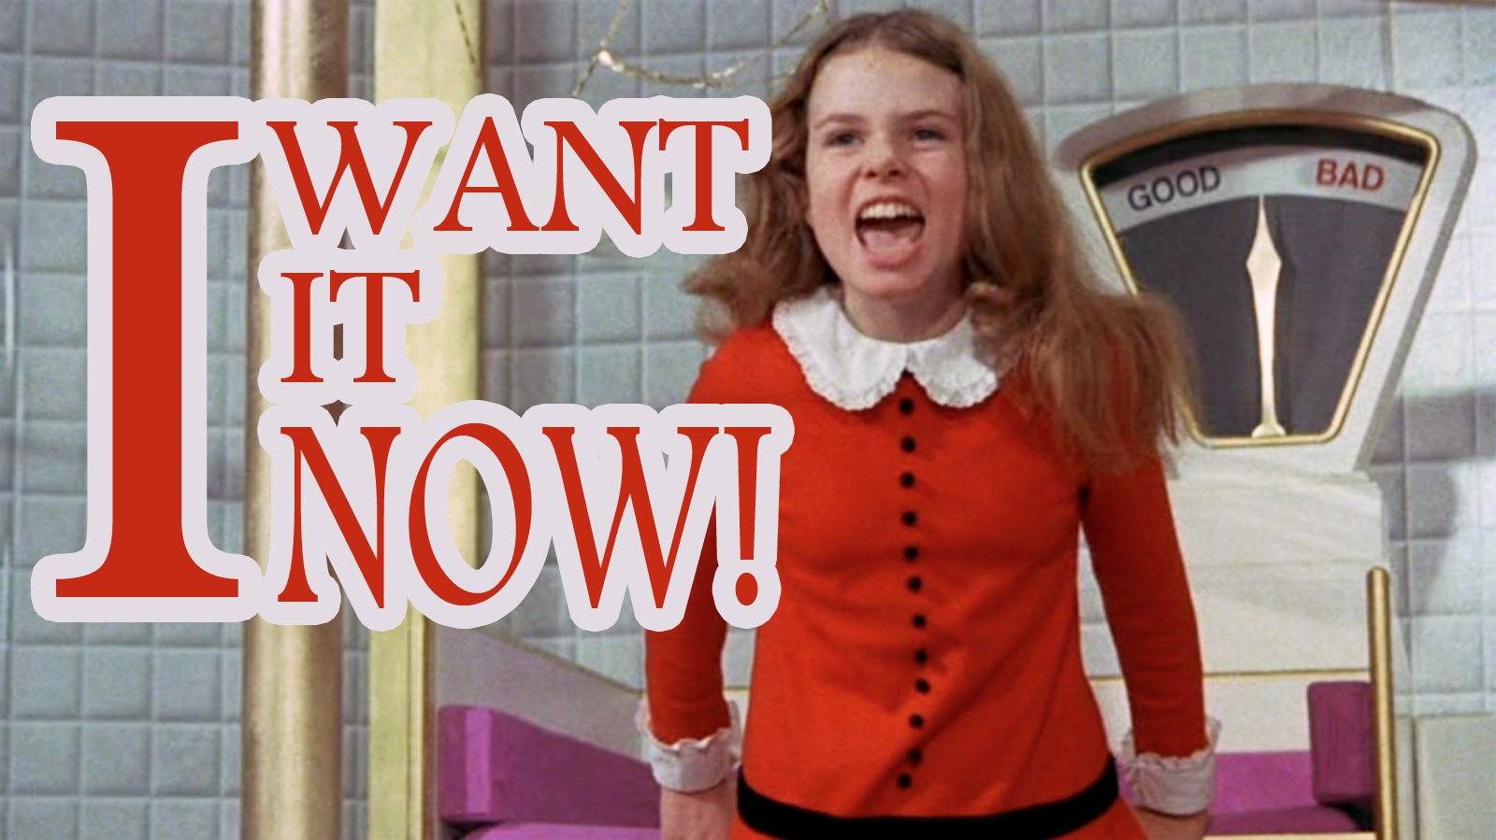

Slide 2
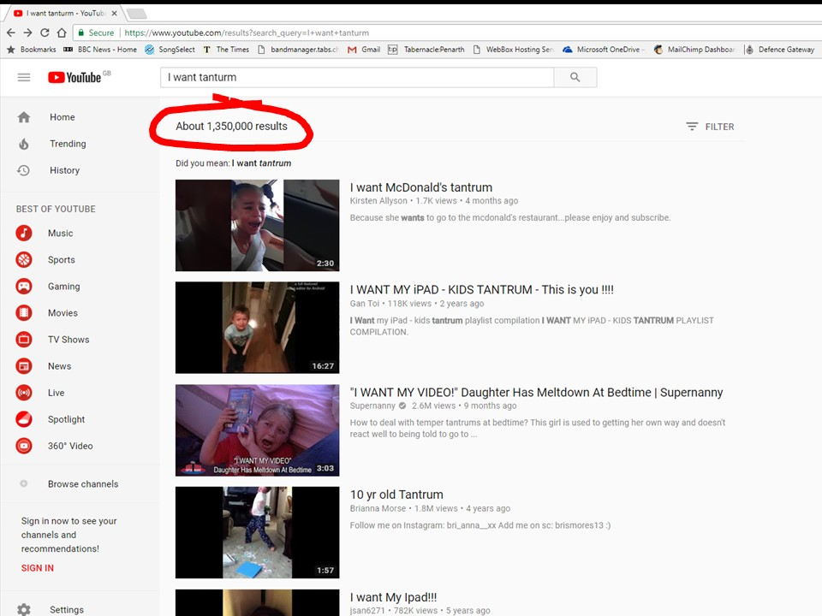

Slide 3
BUT
GOD…
Sunday Evenings 6.00pm at tabernacle:penarth
Discovering how knowing God changes everything

Slide 4
David Wanted
BUT
GOD…

Slide 5
David Wanted
“I had it in my heart to build a house as a place of rest for the ark of the covenant of the Lord.”
1 Chronicles 28:2
BUT
GOD…

Slide 6
David Wanted
David Listened
“But God said to me…”
1 Chronicles 28:3
BUT
GOD…

Slide 7
David Wanted
David Listened
David Obeyed
“So… be careful to follow all the commands of the Lord…”
1 Chronicles 28:8
BUT
GOD…

Slide 8
David Wanted
David Listened
David Obeyed
David Rejoiced
BUT
GOD…

Slide 9
BUT
GOD…
Sunday Evenings 6.00pm at tabernacle:penarth
Discovering how knowing God changes everything

