Slide 1


Sunday Mornings 10.30am at tabernacle:penarth
Verse by Verse through Paul’s Letter to the Galatians

Slide 2


Slide 3
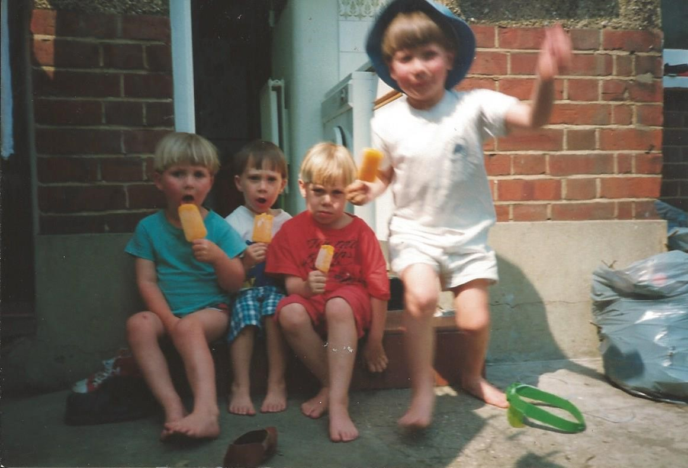

Slide 4
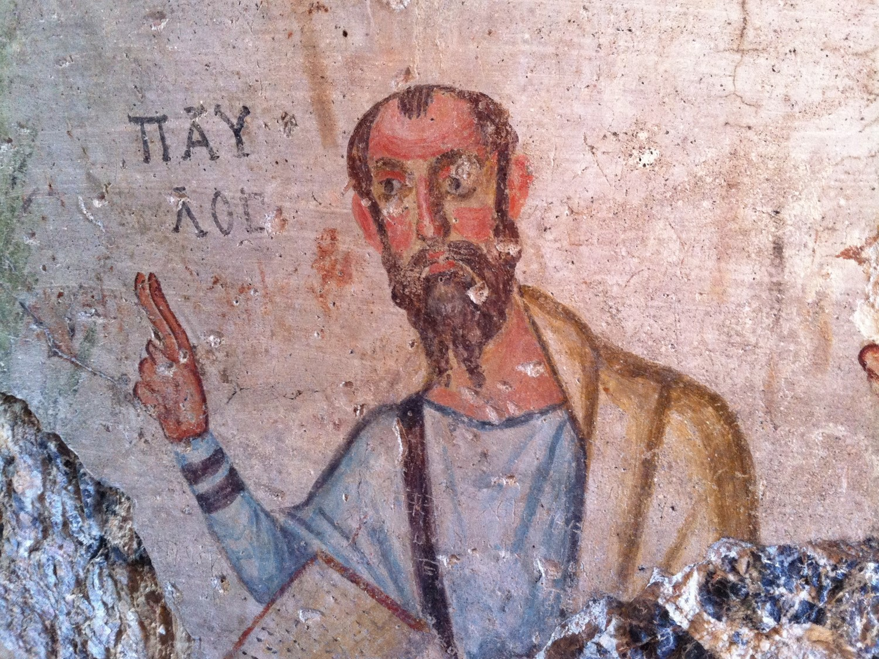

Slide 5
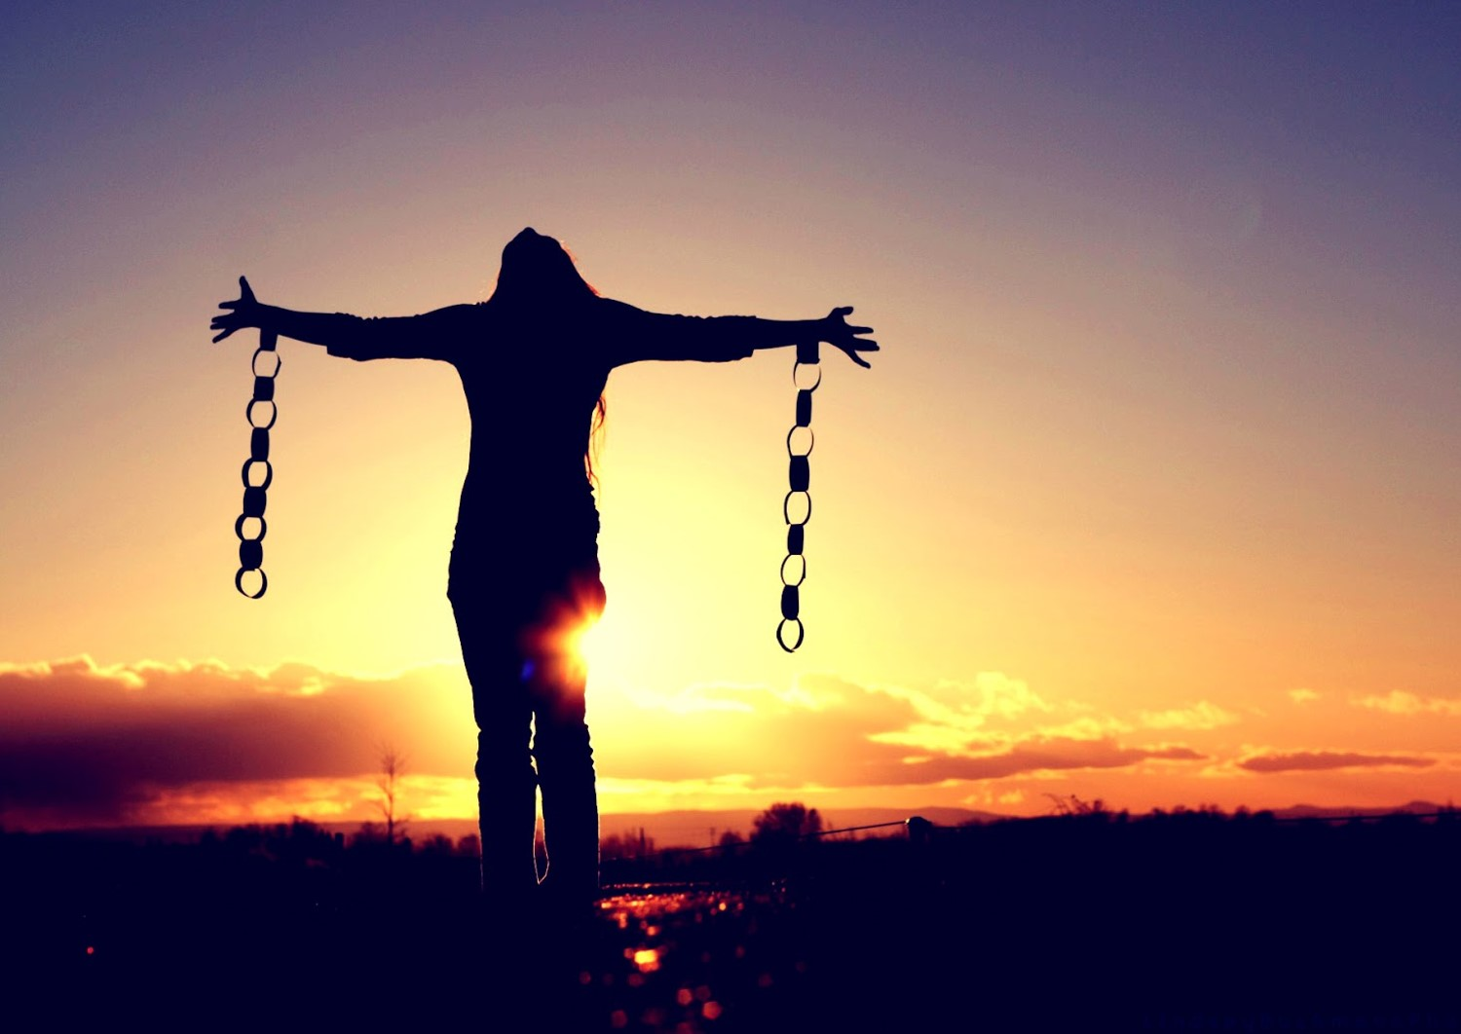

Slide 6
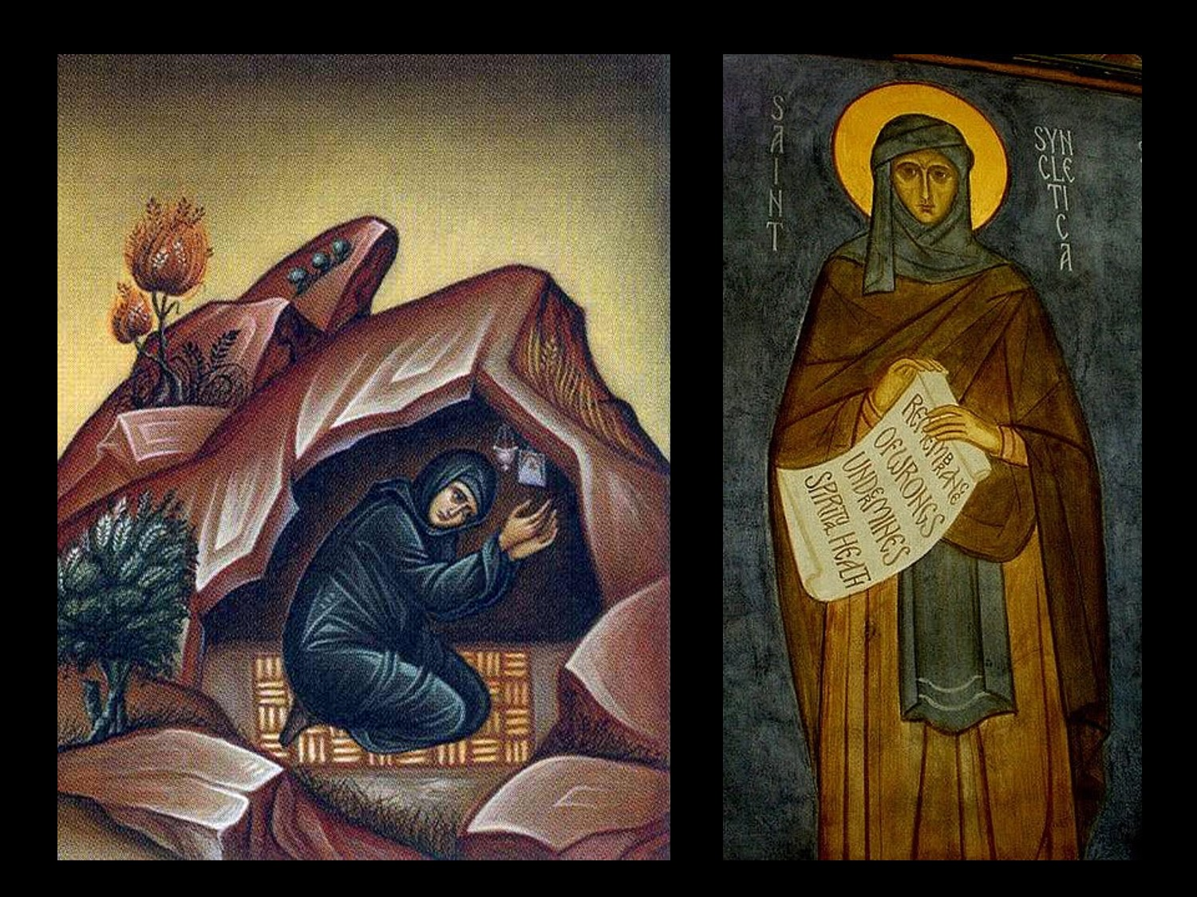

Slide 7


Slide 8


