Slide 1
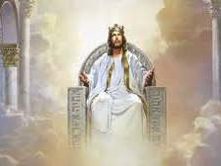
I want God’s counsel

