Slide 1
HUMILITY
Philippians 2:1-11

Slide 3
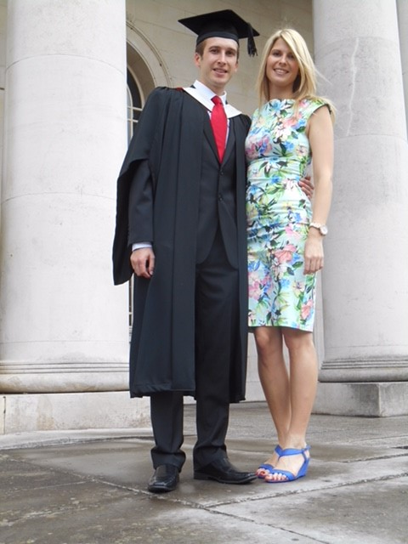

Slide 4
LOVE

Slide 5
LOVE
ONE IN SPIRIT AND PURPOSE

Slide 6
You were planned for God’s pleasure
You were formed for God’s family
You were created to become like Christ
You were shaped for serving God
You were made for mission
RICK WARREN – The Purpose Driven Life

Slide 7
LOVE
ONE IN SPIRIT AND PURPOSE
VALUING OTHERS – SELFLESS SERVANT

Slide 12
Giving up our desires
Becoming less so others can become more
Being obedient to God’s call whatever the cost

Slide 14
LOVE
ONE IN SPIRIT AND PURPOSE
VALUING OTHERS – SELFLESS SERVANT
EMULATING JESUS

Slide 15
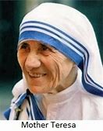
To speak as little as possible of one’s self
To keep busy with your own affairs, not those of others
To avoid curiosity
Do not interfere with the affairs of others
Accept small irritations with good humour
Do not dwell on the faults of others
Accept censures or criticism even if unmerited
Give in to the will of others
Accept insults and injuries
Accept contempt, being forgotten and disregarded
Be courteous and delicate even if provoked
Do not seek to be admired or loved
Do not protect yourself behind your own dignity
Give in , in discussions, even when you are right
Choose always the more difficult task

