Slide 2
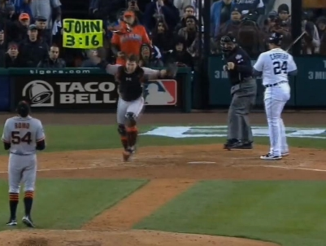

Slide 3
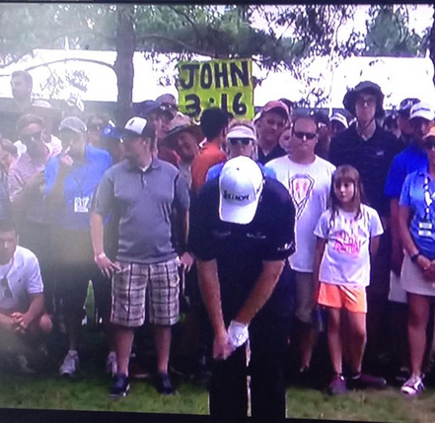

Slide 5
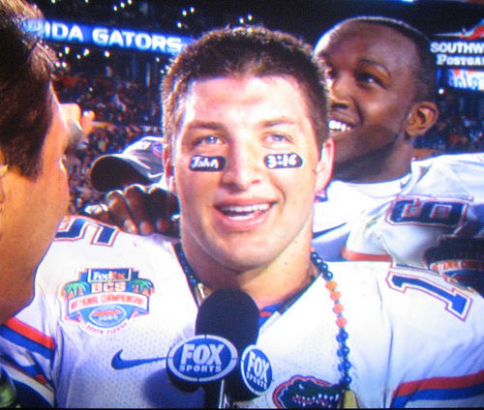

Slide 7
“Do not be anxious, saying, ‘What shall we eat?’ or ‘What shall we drink?’ or ‘What shall we wear?’ For the Pagans seek after all these things, and your heavenly Father knows that you need them all. But seek first the kingdom of God and his righteousness, and
all these things will be
added to you.”
Matthew 6:31-33

Slide 8
‘You (plural) must be born again.’
John 3:7

Slide 9
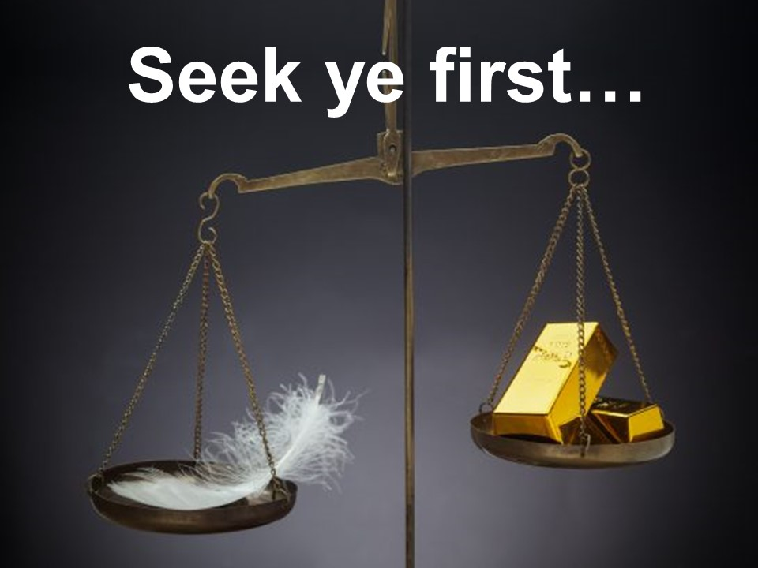

Slide 10
Flesh – Spirit

Slide 11
Flesh – Spirit
Perish – Eternal Life

Slide 12
Flesh – Spirit
Perish – Eternal Life
Darkness – Light

Slide 13
Flesh – Spirit
Perish – Eternal Life
Darkness – Light
Not condemn - condemned

