Slide 6
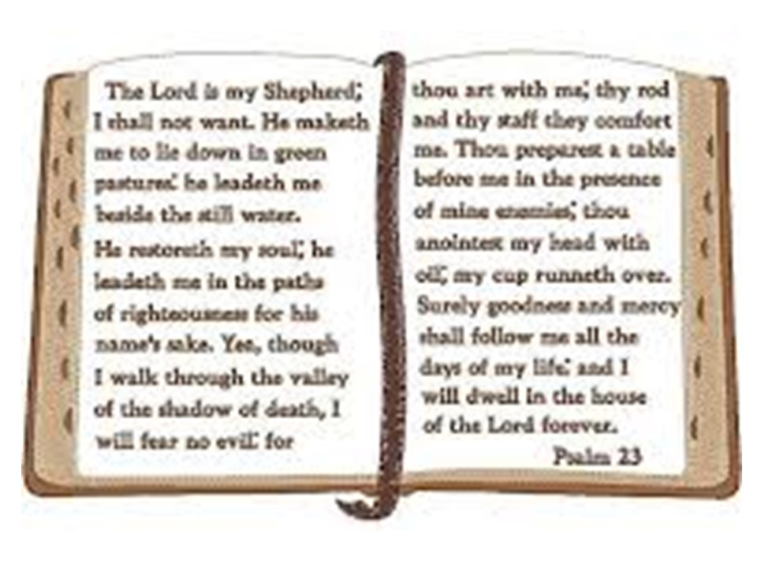

Slide 8
Pray
Read the Word
Take Time out
Listen

