Slide 1
Notes:
Well good morning everybody and happy st davids day. Why don’t you turn to the person next to you and say happy st davids day and welcome people to church
and its great to come and share god with you this morning. My name is matt huckle, I am a pastor just outside of southampton, which is great being close to the best football team in the world! Why don’t you turn to the person next to you and say good morning and welcome them to church. If you don’t know them, then invite them for a coffee afterwards.

Slide 2
Notes:
I don’t know if you have seen southampton recently but this is what it looks like!!
Usually my day of in the week is a Thursdays and last Thursday in a spontasciy way I said to Emma right after school lets take the kids on a bike ride. You take our youngest Ava and I will take Jonah our eldest and Lucy and we will meet you there!
Jonah lead the way and we met Emma at the park it was fun, we decided that Emma would take Lucy and Ava home and Jonah and I would cycle home. I thought and said to Jonah, follow me, lets go a different way home. Through out that journey, Jonah remained close has he had no idea of where we were going.
I wonder if this bike journey represents your journey with god?
are you like Jonah on the first part of the journey out in front with me behind
or are you like Jonah on the second part with Jonah close behind because he is not sure where he is going.

Slide 3
Notes:
I don’t know if you have seen southampton recently but this is what it looks like!!
Usually my day of in the week is a Thursdays and last Thursday in a spontasciy way I said to Emma right after school lets take the kids on a bike ride. You take our youngest Ava and I will take Jonah our eldest and Lucy and we will meet you there!
Jonah lead the way and we met Emma at the park it was fun, we decided that Emma would take Lucy and Ava home and Jonah and I would cycle home. I thought and said to Jonah, follow me, lets go a different way home. Through out that journey, Jonah remained close has he had no idea of where we were going.
I wonder if this bike journey represents your journey with god?
are you like Jonah on the first part of the journey out in front with me behind
or are you like Jonah on the second part with Jonah close behind because he is not sure where he is going.

Slide 4
Notes:
This morning we start a new series looking at the book of Isaiah and for the next four weeks we are looking at what we call the four servant songs. And these are prophecies of the future messiah -
There are four “Servant Songs” of Isaiah
that describe the service,
suffering,
and exaltation of the Servant of the Lord, the Messiah.
All four songs show the Messiah to be God’s meek and gentle Servant.
He is a royal figure, representing Israel in its ideal form;
He is the high priest, atoning for the sins of the world.
Isaiah predicts that this Servant of the Lord would deliver the world from the prison of sin.
The book of Isaiah is a great book to get your teeth stuck into, it takes time but there are some amazing stuff that brings light to the new testament and the role of jesus.

Slide 5
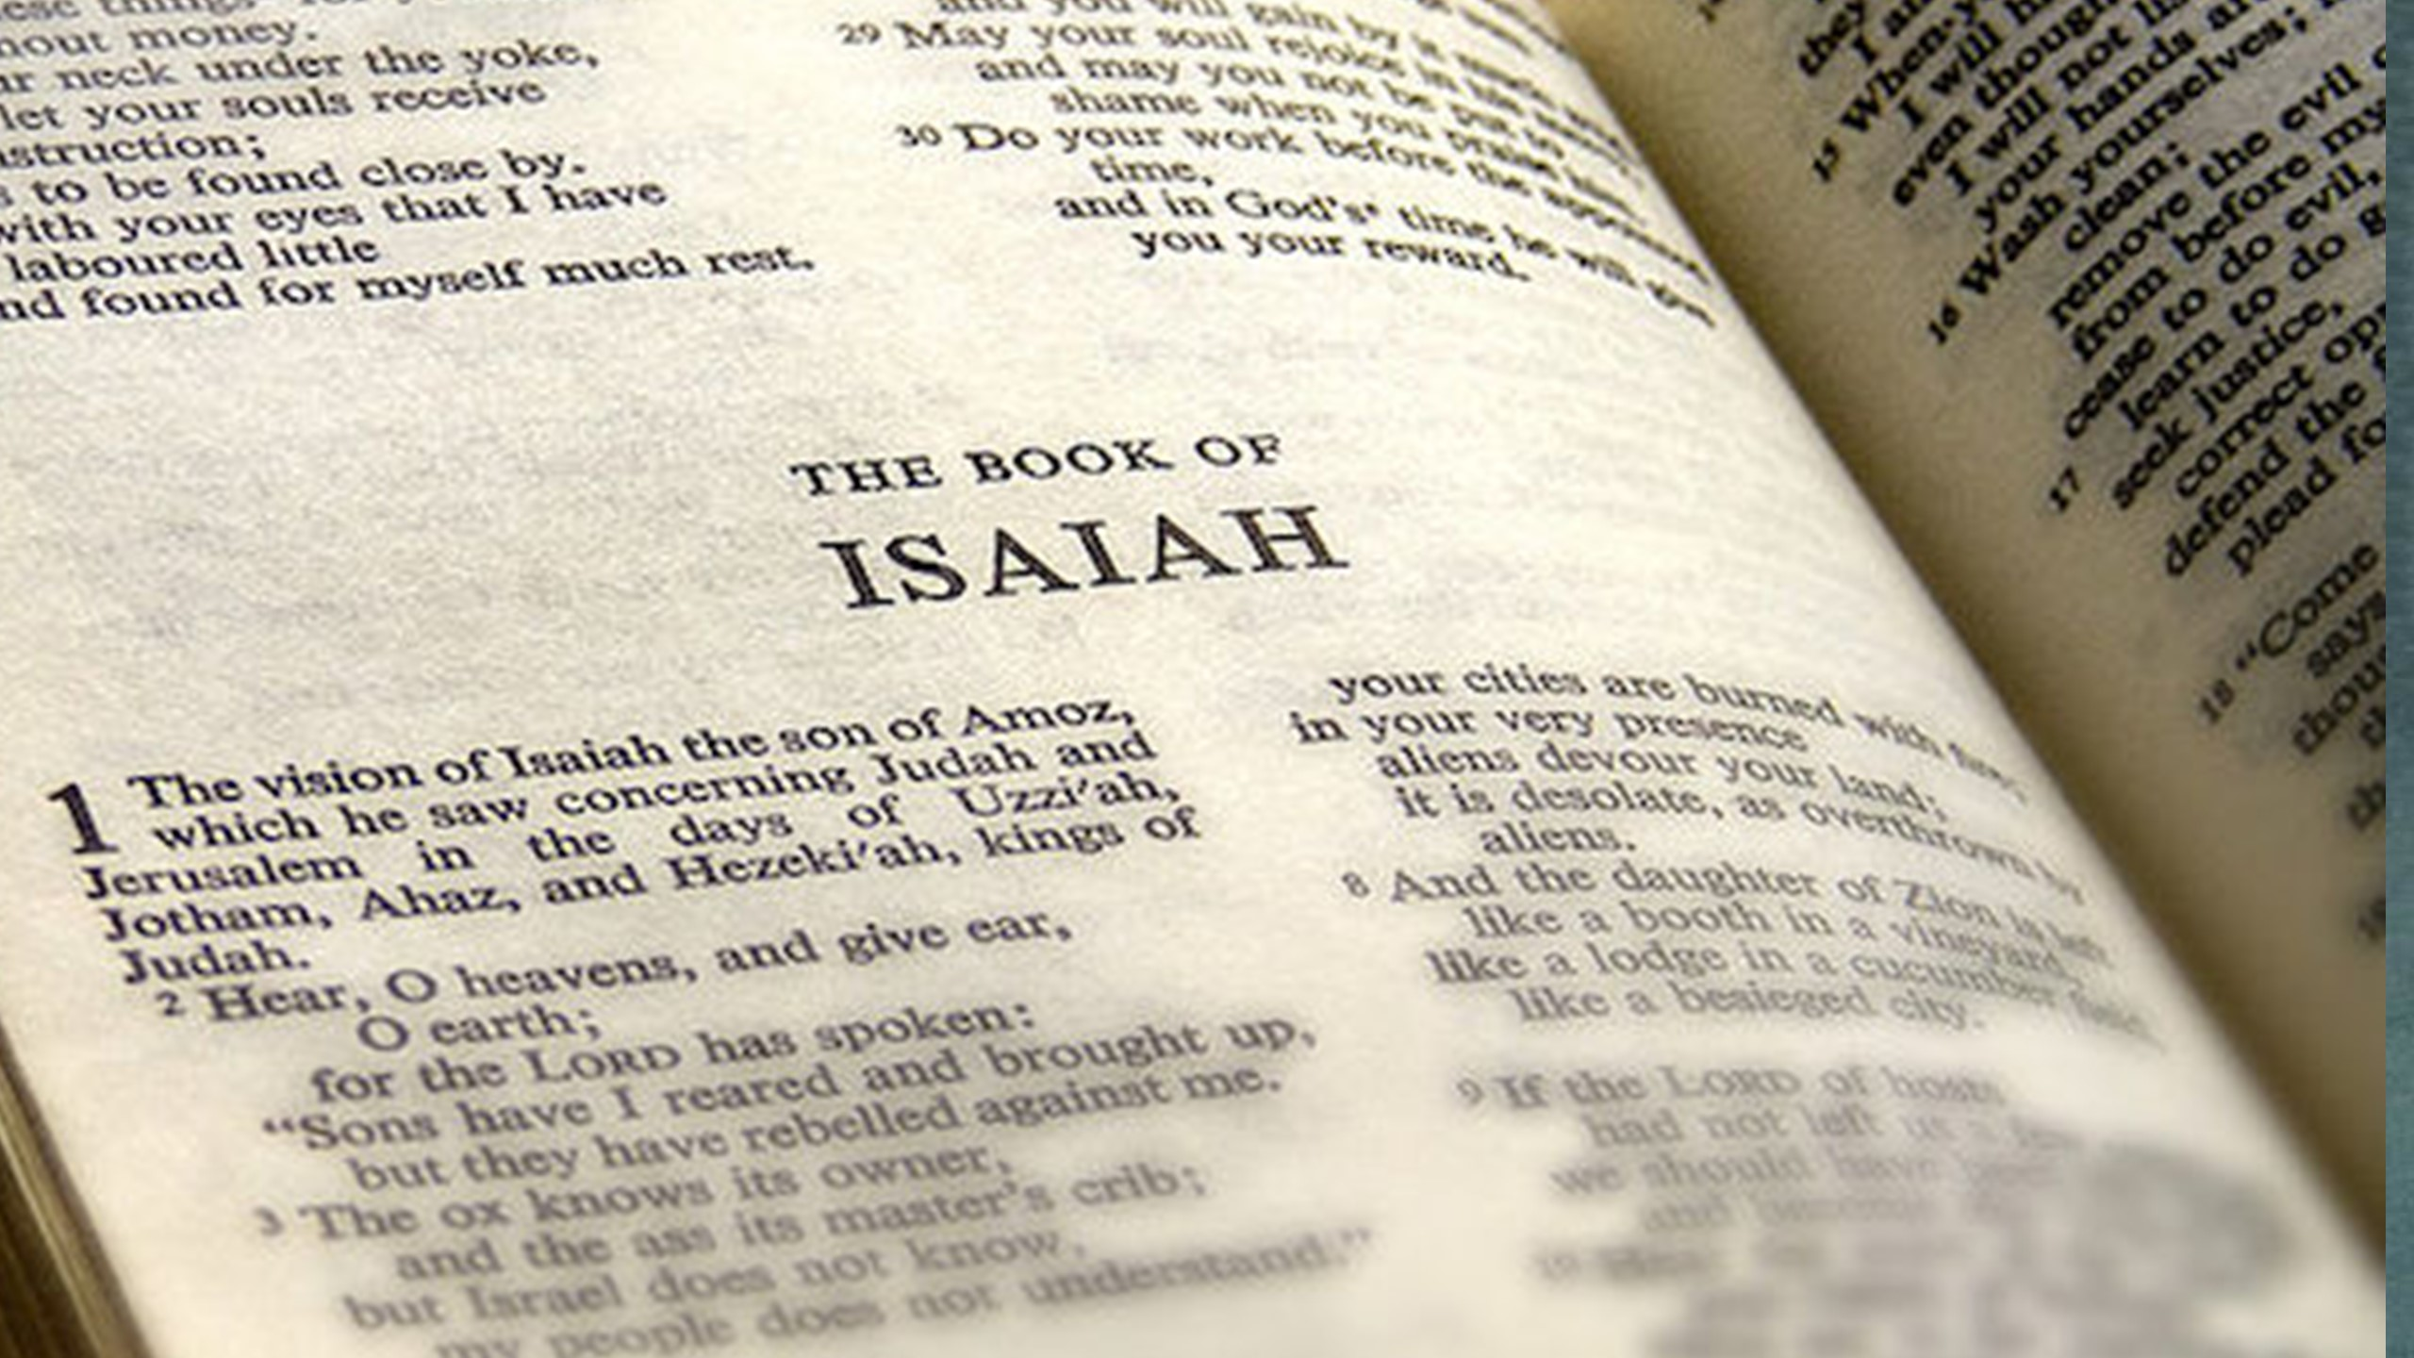
Notes:
There are three sections to the book of Isaiah.
The first section chapters 1-35 looks at the time of Isaiah. Here he is talking to he fellow contemporaries. He lived in Jerusalem and he spoke on gods behalf to the Jerusalem leaders and the leaders of judah. His message was that judgement was going to come and if they didn’t follow his commands then he would allow Assyria and then later on Babylon to come and judge them if they continued to persit in idolatry. But like wise this was equal to a message of hope. That god would send a king from the David line.
The second section of Isaiah, Chapters 36-39, is a historical bridge between the first and third sections and introduces at least one of the causes of the Babylonian captivity.
In the third section, Chapters 40-66, Isaiah speaks about the
Babylonian captivity, which is to take place at least 130 years after his time.
He predicts its coming, tells them what it will be like, predicts the regathering to the land, the rebuilding of the temple, and the restoration of the nation in Judah.
But he also talks about a hope - In the closing chapters, 40-66,
Isaiah talks about one who is designated as the Servant of the Lord,
the Servant who will bring salvation,
the one through whom God will accomplish his purposes in the nation.
This one is very much the center of Isaiah's thinking, particularly in the section from Chapters 40 through 53. This song in the first four verses of Chapter 42 is the first of these references to the Servant of the Lord.
So often when we read these four songs - we see them with new testament eyes

Slide 6
Notes:
Sue rang to her deacon and said look its Jesus in the old testament
We often look at this from a new testament perspective which is great
But its also important to reflect upon it with a view how they would have heard it!
If we jump back a chapter and reflect upon that chapter we see we are in a court scene

Slide 7
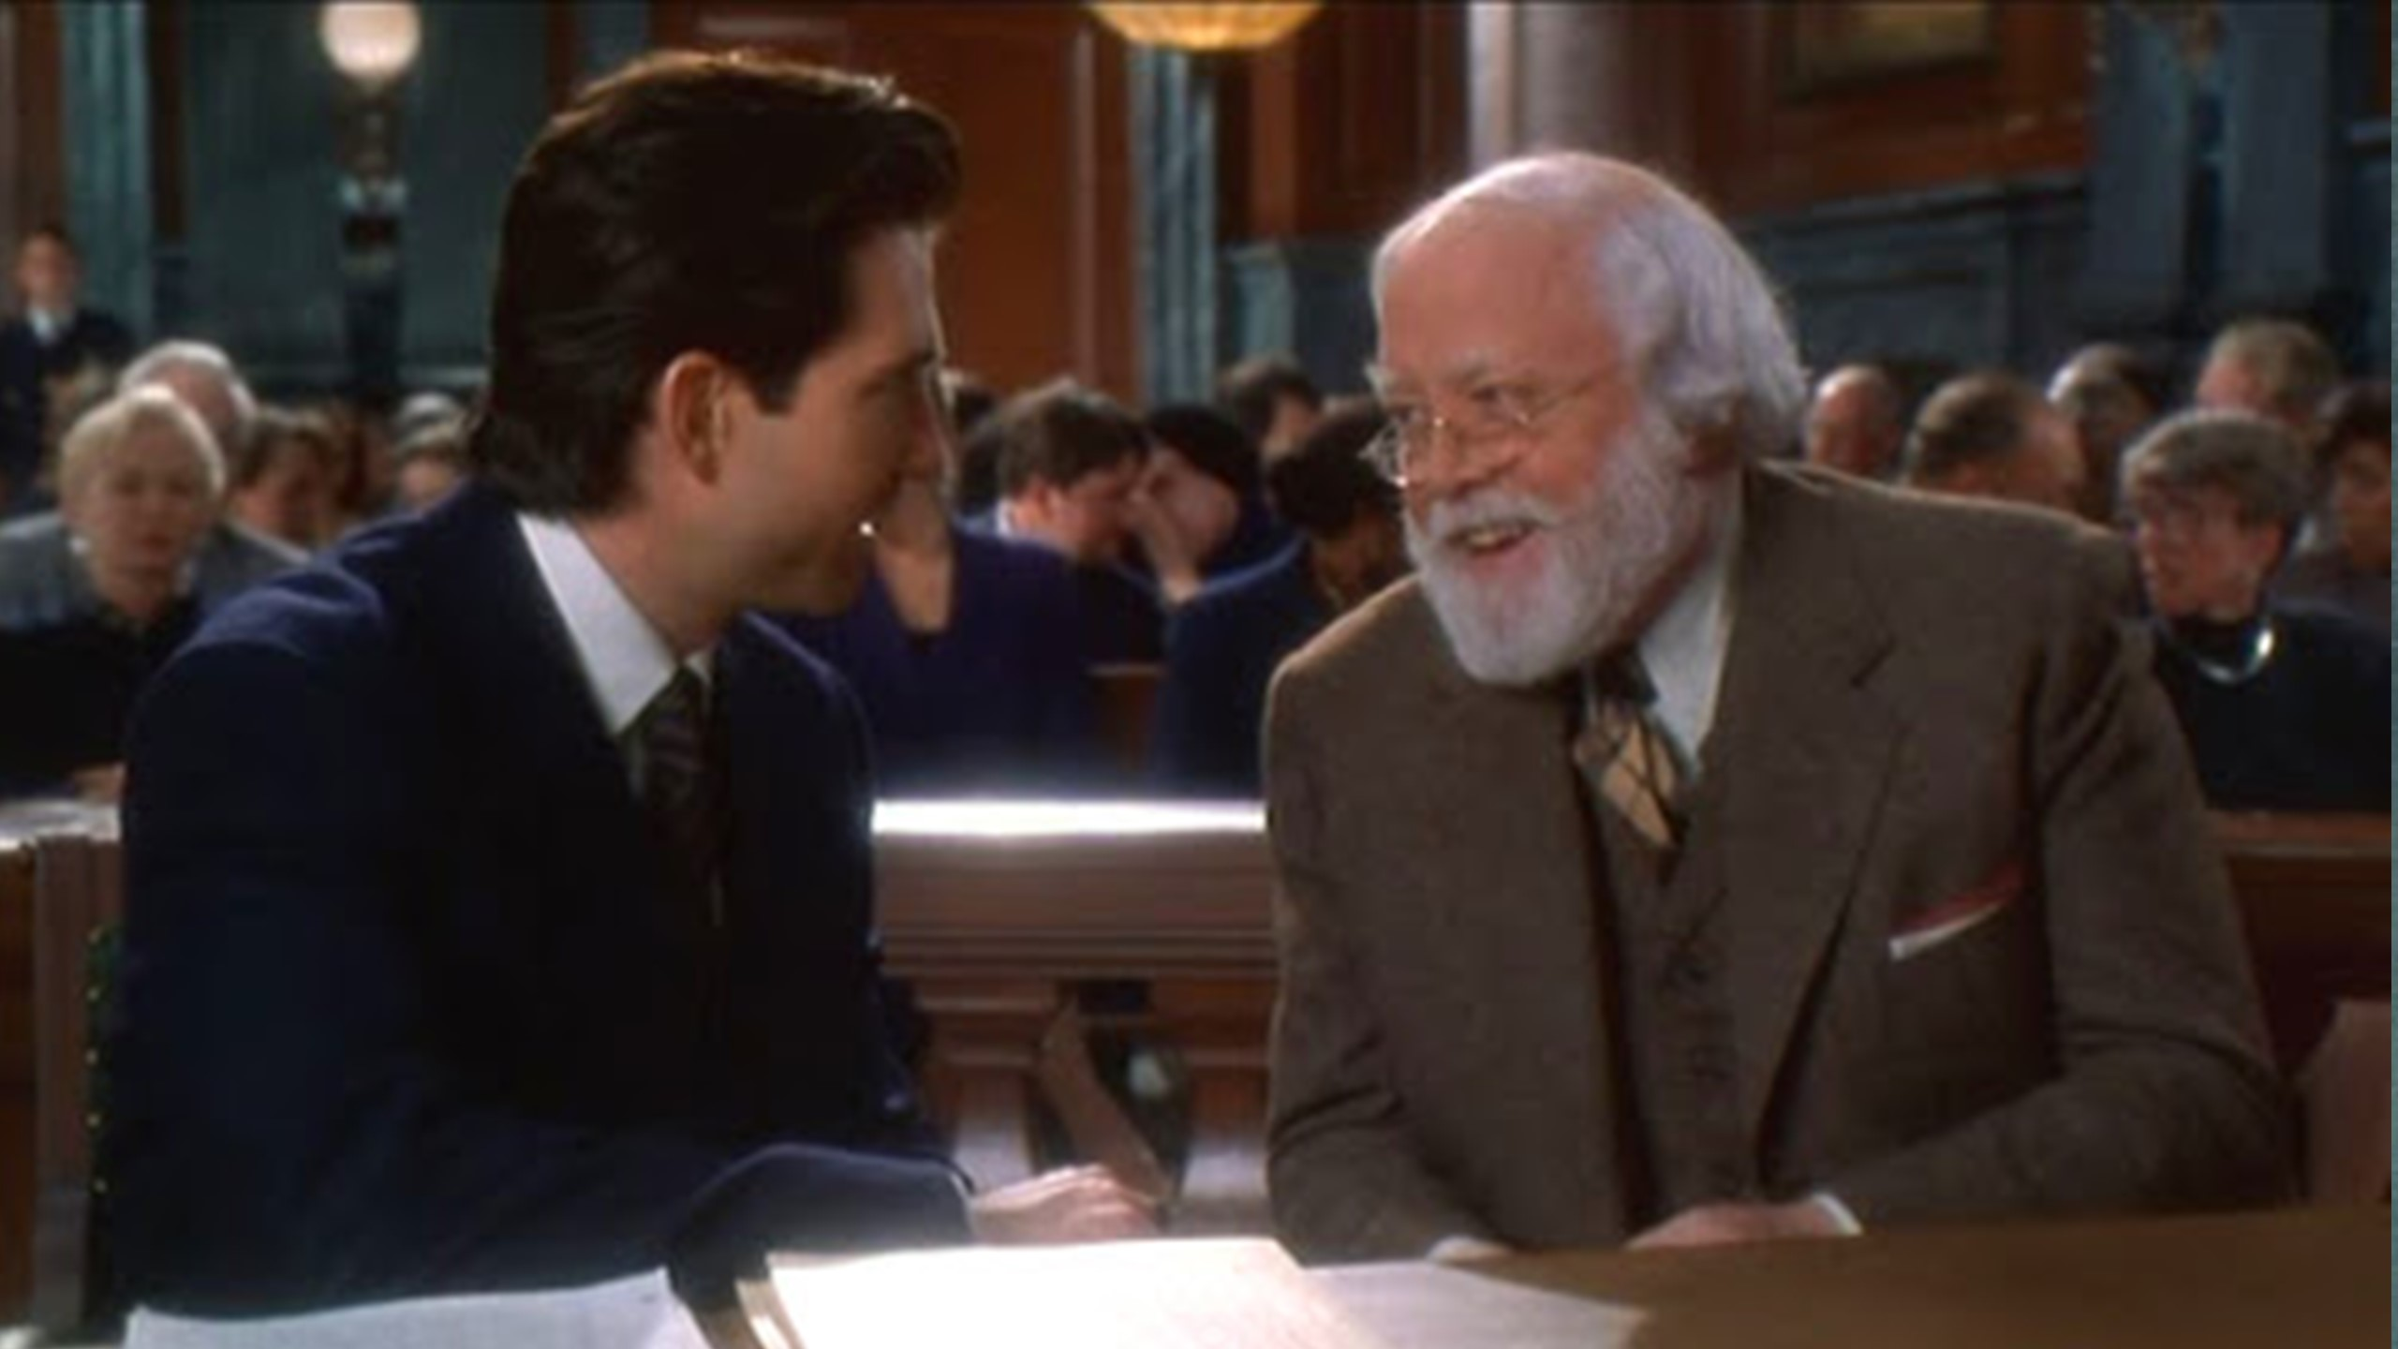
Notes:
God has brought a prosecution case before his people. They have been guilty of idolatry: they have been worshipping a god of their imagination. And there is a consequence for that. Who is going to be the one to bring justice.
In a climactic moment he ask the idols speak for themselves, but they have remained dumb and lifeless.

Slide 10
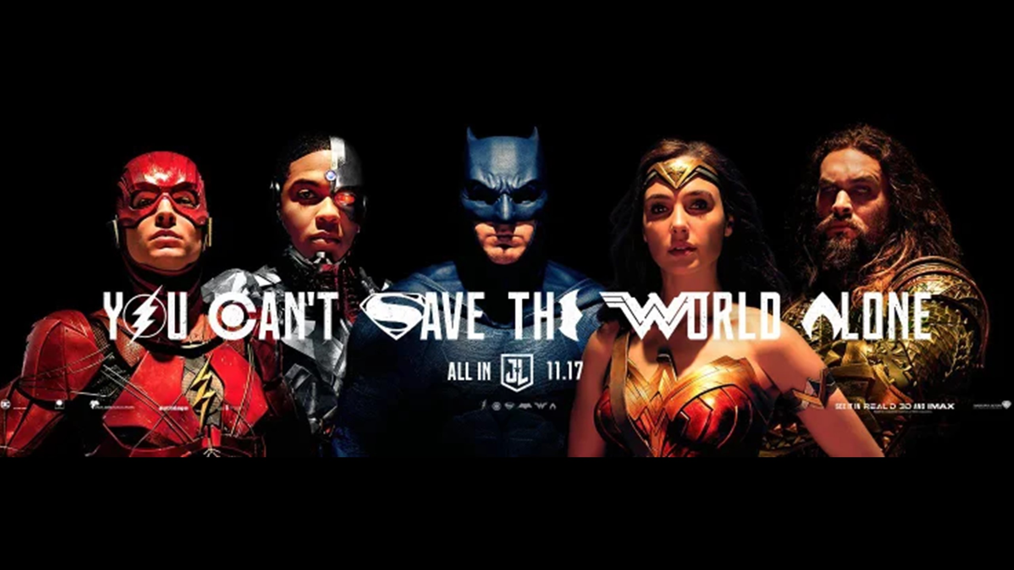
Notes:
Are we guilty of the same. Paul says in col 3:15 5 Put to death, therefore, whatever belongs to your earthly nature: sexual immorality, impurity, lust, evil desires and greed, which is idolatry.
when we reflect upon the idols that we worship - sex, money, greed, pride, celebrities, sports etc if god called those to a stand would they stand up for us, would they bring justice to this world?
The people are surely guilty. We are guilty, No other god/ idol will ever save them!
Which leads us to our passage this morning. He god says I have someone. Someone who is going to bring justice to the nation! And this is the theme of this who opening song!
In twelve lines he says three times that this one, the Servant of the Lord, will bring forth justice.
In other words, this is the one who will set things right, because that is what the term "justice" means. He will establish things as they ought to be.
On the seven mile journey form Jerusalem to emmaus, Jesus opened up the old testament to two confused and discouraged disciples, showing them as never before that these sometimes dry and often confusing pages were in fact full of himself (luke 24:!3-35).
In one sense all the old testament finds its focus in Jesus
But with out old testament lens back on,
we have to remember that this was worrying times for god chosen people. They were recently harassed by Assyria and soon to be captive in babylon, there was a feeling that god had not forgotten them.
They may have to be punished for their backsliding.
But we know God will not abandon his own.
God promises are sure, that is something Isaiah is keen to underline “my word….will not return to me empty” (isa 55:11). The grace of god is so evident.
The future was going to be very stormy indeed for gods people.
They had sinned and they were going to suffer for it.
When god comes in judgement it is a fearful time. “but who can endure the day if his coming?
Who can stand when he appears (mal3:2)” —->>I remember someone saying the more you know god the more that you fear him! With new testament eyes we see God as loving and gracious and I don’t disagree with that, but just is righteous and hates sin.
Already we have seen many great people in the old testament sent by god yet none of them can keep the covenant on behalf of israel.
All of them - Abraham, Isaac, Jacob, Joseph, Moses, Joshua, samson, Samual, David, solomon, Elijah, Elisha, Jonah even Isaiah himself - all had fallen short. What Israel needed was a saviour.
The saviour would come as promised.
He would be a servant a prophet like Moses, but a far better mediator,
a king like David but one who is seated on an eternal throne.
The new Israel could only be established in the person of the lords servant.

Slide 11
Notes:
Sometimes it so important to stop!
I sometimes stop and just reflect upon
The kids
The roof over my head
The birds
The sea
Sometimes its so important to marvel at what god is saying in this passage!
The god of ages is going to step down from glory. To come and save humanity!
The king of kings, the lord of lords comes down as a servant!

Slide 12
Notes:
We know that Jesus said he came to serve and not be served. - dictionary definition - a person who performs duties for others, especially a person employed in a house on domestic duties or as a personal attendant.
Have you heard the song from Phil Wickham called “living hope”? There is a line in it that strikes me - The God of ages stepped down from glory
This god of all glory - stepped down to become a servant! To come and serve you and me.
Matt 20:28 says - 8 just as the Son of Man did not come to be served, but to serve, and to give his life as a ransom for many.”
But even in these 5 descriptions, it shows us his deity as well as his humanity!
His deity was shown through his being chosen, the spirit on him
But it also shows his humanity - upholds - The term "uphold" means to take hold of something. It means to strengthen someone by taking a grip on them. That is what the Father does to the Servant, the Lord Jesus. The Lord Jesus derives his strength from the Father.
We normally think of the Lord, since he is God, as sufficient in himself. But the Lord himself tells us that his strength was given to him from the Father. He was not strong in himself.
. He himself had to depend on the Father for his strength.
There was simply no other way that he could carry out the ministry that the Father had given to him.
And then verse 2-4 share to us how he is going to do it. How was he going to bring justice, through quientess, gentleness, strength, and faitfulness

Slide 13
Notes:
What is he going to do
▣ "He will. . ." Notice the things the servant will do (series of imperfect verbs).
1. bring forth justice to the nations (i.e., universal implication, cf. Isa. 42:1; 4b,c)
2. will not cry out, Isa. 42:2
3. will not raise His voice, Isa. 42:2
4. will not make His voice heard in the street, Isa. 42:2
5. will not break a bruised reed, Isa. 42:3
6. will not extinguish a dimly burning wick, Isa. 42:3
7. will faithfully bring forth, Isa. 42:3
8. will not be disheartened, Isa. 42:4
9. will not be crushed, Isa. 42:4
10. will establish justice in the earth, Isa. 42:4
And then verse 2-4 share to us how he is going to do it. How was he going to bring justice, through quientess, gentleness, strength, and faitfulness

Slide 14
Notes:
This shows us the character of who the servant is 4 aspects of that character
Quietness
He will not shout or cry out, or raise his voice in the streets 42v2
The word shout is described as a thunderbolt or a raging bull. Have you ever listened to a sergeant major drilling his men? - share what happened with the army on wednesday. Jesus never dealt with his disciples that way. There was no screaming or shouting of orders. He did not assume the role of a military commander. People wh have to shout have, generally, wither a poor case to make or are insecure about the respect they can expect.
2 gentleness
When the pharisees were conspiring together to destroy jesus, thereby revealing the wickdeness of their hearts,
Matthew reveals the gentleness that lay in Jesus heart by quoting this verse from Isaiah about a bruised reed and a smouldering wick.
Hardly anything could be more tender and fragile than a bruised reed or a smouldering wick. Imagine trying to salvage a burnt piece of paper form the fire and how easily I t breaks into a thousand pieces in your hand, if you have ever tried to restart a fire that has almost gone out, you will know how tenderly you must deal with it. If you disturb it too much, or blow on it too hard it is sure to go out.
Some of th elords people were just like this: bruised and battered and feelings though they were about to be extinguished. They were discouraged and lacking assurance. Isaiah comforts them by telling them of gods servant whose dealings with them will be gentle.
And we see this in the way Jesus did his ministry
Luke 7:36-50 - Jesus Anointed by a Sinful Woman with perfume
Matthew 8:5-13 - Jesus healed the centurion servant
John 4 women at the well
John 8:1-11 - adulterous women and stoning
How gentle was he with them
How are you this morning?
Cast all your anxiety on him Peters says. Because he cares for you 1 Peter 5:7
3. Faithfulness
In faithfulness he will bring forth justice 42:3
God abounds in faithfulness (exodus 36:4) and his servant will be like hi in this.
When we study God’s Word, a pattern emerges.
We learn that God never changes and never lies (Numbers 23:19; 1 Samuel 15:29). We learn through Scripture that God has never failed in the past (Isaiah 51:6). He was always true to His Word as He worked in the lives of the ancient Israelites. When He said He would do something, He did it (Numbers 11:23; Matthew 24:35). We begin to build trust upon His proven character. We can trust that God will be true to Himself. He will never cease acting like God. He will never cease being sovereign, being holy, or being good (1 Timothy 6:15; 1 Peter 1:16).. In a world of injustive, Jesus is someone who can always be relied upon to be fair and just!
4. Strength
he will not falter or be discouraged till he established justice o hart. In his law the island will out their hope 42:4 - gods servant will not grow dim, or give poor light like a flickering wick. He will not be crushed like a bruised reed. He will be a saviour of strength and power, of stamina and courage. Though he will be a Servan, he will also be a king!

Slide 15
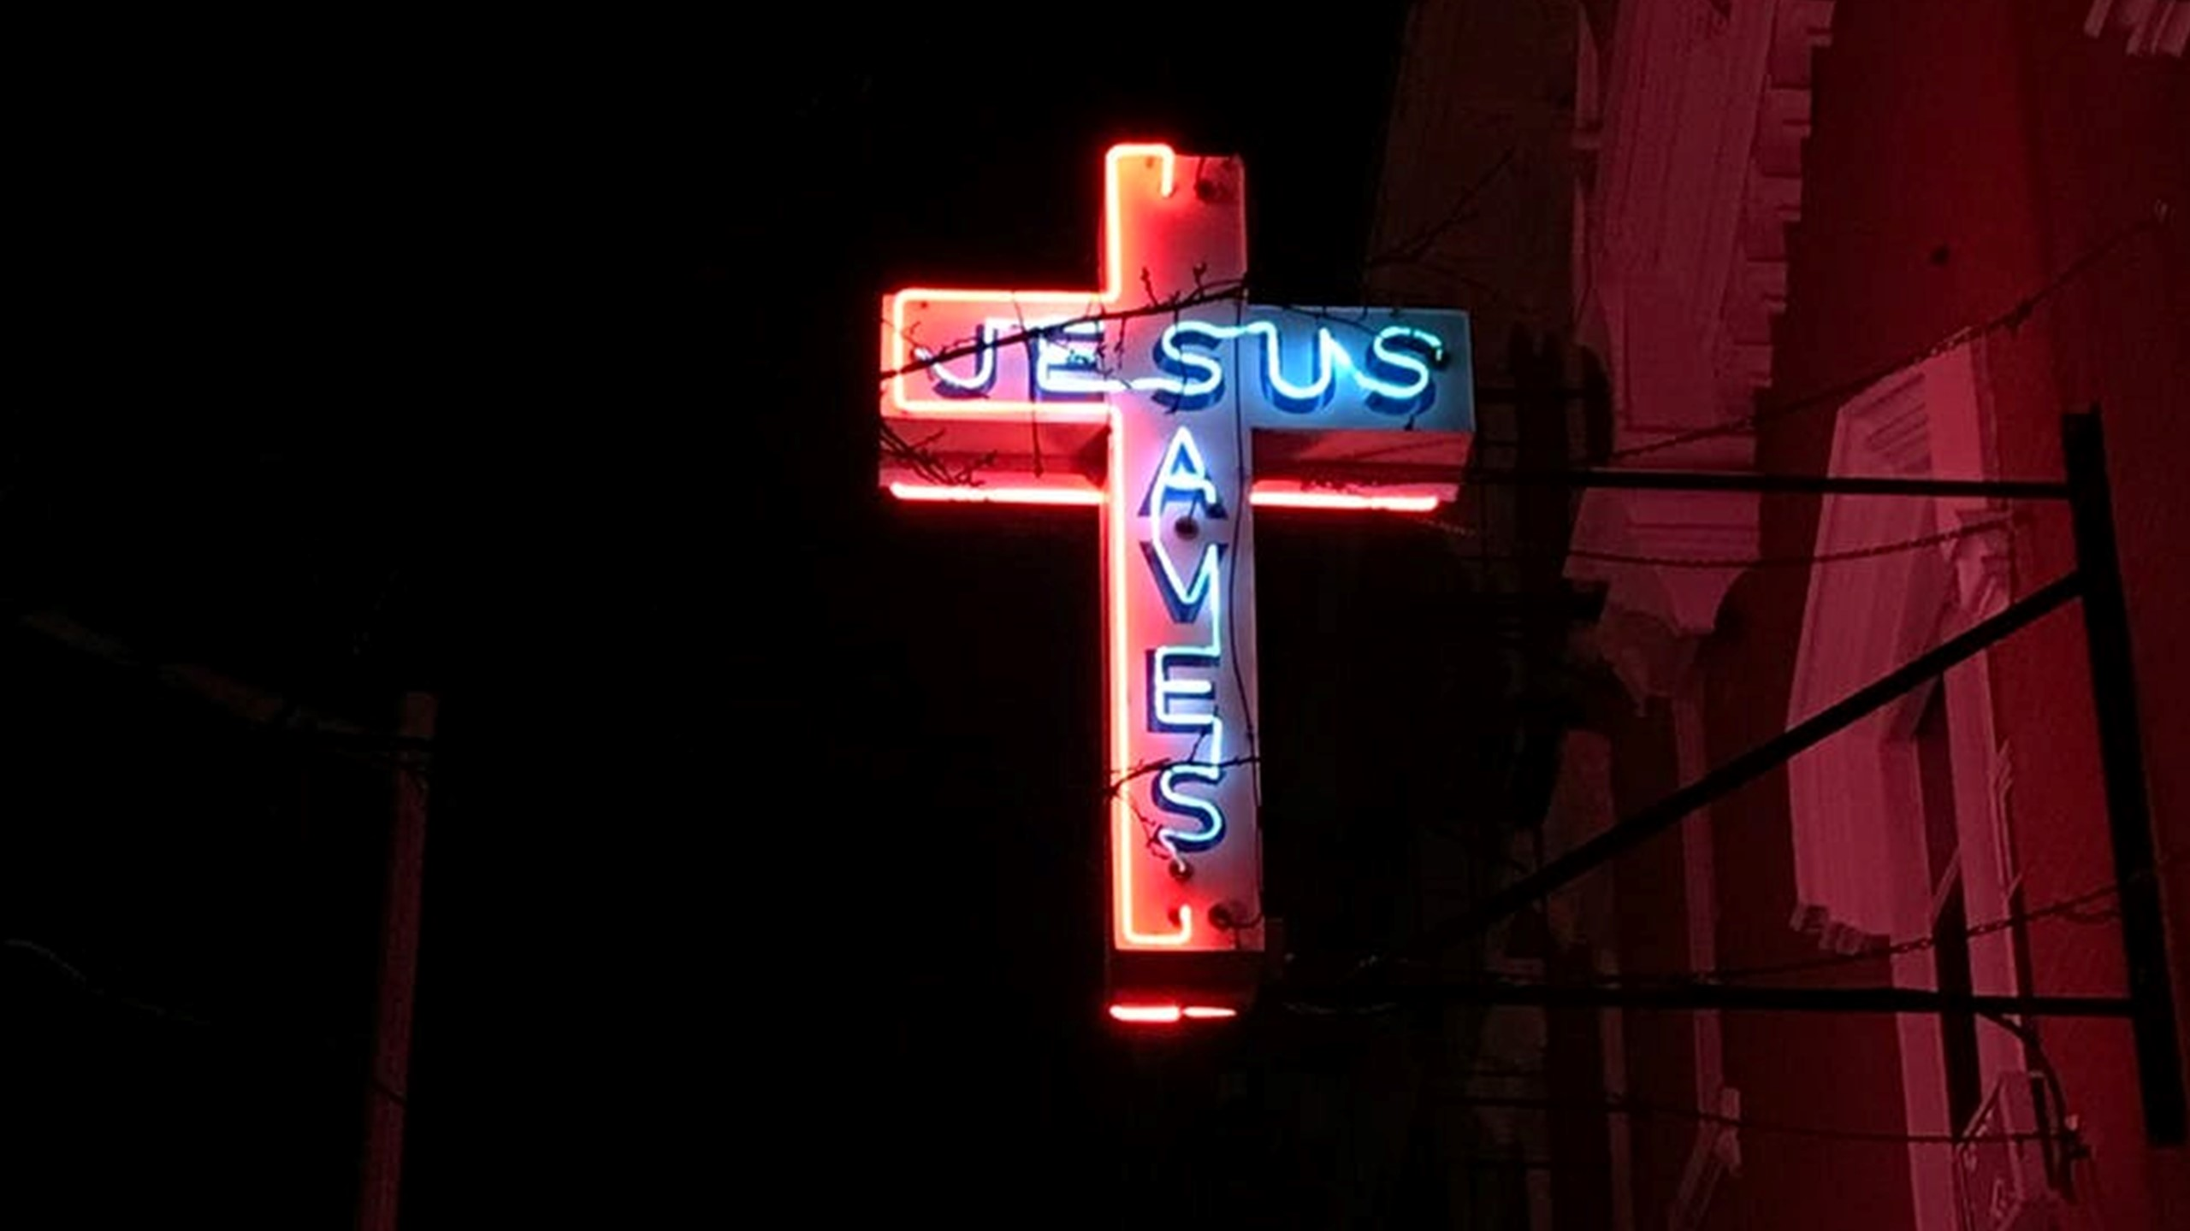
Notes:
This was all part of gods plan! Through all of this, god brought justice to the world.
“God made him who had no sin to be sin for us, so that in him we might become the righteousness of God” (2 Corinthians 5:21).
This is an amazing truth. On the cross, (martin Luther said the great exchanged happened). Jesus exchanged our sin for His perfect righteousness so that we can one day stand before God and He will see not our sin, but the holy righteousness of the Lord Jesus. Justice has been served!
We were sinners (roms 3:23)
We are helpless (john 6:44)
We are under god’s wrath (eph 2:3)
Gods wrath ultimately means hell ( 1 these 1:10)
Good news doesn’t become good news until we perceive what the bad news is
Bad news - we are lost, helpless, heading for hell
Good new: Jesus died to change all of this!
And this is the hope, and this is the promise and this is who Isaiah is talking about
John 3:16
This was gods plan for us all to as romans says be justified by faith!

Slide 16
Notes:
But there is a big challenge here!
What’s god plan for you?
Are you leading your own plan? Are you allowing your culture to influence the plans. Because culture teaches us that the more money you have the more successful you are in life terms. Are you dictating the terms to god about your future or are you allowing him to detate you life?
Just like the story at the start - where are you on the bike joureny are you leading the way with god behind you or are you tucked in behind god as he directs you.
Because if you are tucked inbehind allowing him to lead you then this passage is talking to you.
Jesus came to bring justice in this world so that we can be in relationship with god, so that we can be called children of god so that we can have a hope and a future.
——>>>> St David was a special man, why because he had a passion for the gospel and he saw many miracles. We remember him because of the spread of christianity in wales.
But David was just human, no different to you and I. We all have the same calling as he does.
He didn’t do that so we can carry on following idols and going our own way.
Friends we need to allow god to be god of our lives we need to tuck in behind him and follow him.
And that means using this as an example
Because you know that you are called to serve, you know that in tough times god doesn’t leave you.
You know you are chosen, you know you have the spirit of god on you and your call upon your life is to go and make disicples.
Here even in this passage god shows us how we should do this!
We don’t need to shout it out!
We need to be with the poor and the broken
But we do it because he gives us strength and he is faithful
I end with this, Jonah, would have gone back the way he came! It would have been boring - I took him a new way, it was different it was exciting.

