Slide 2
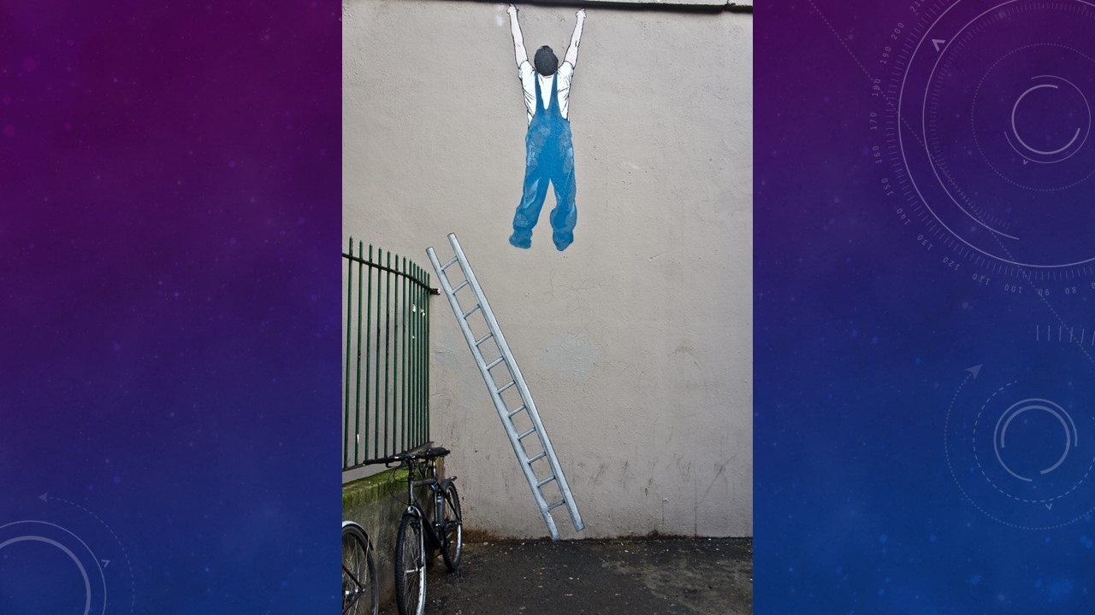
This Photo by Unknown Author is licensed under CC BY-SA

Slide 3
Caleb and the spies

Slide 5
Caleb and the spies
Numbers 13: v 17 - 33
1. Be Strong and courageous

Slide 6
Caleb and the spies
Numbers 13: v 17 - 33
1. Be Strong and courageous
2. Be faithful

Slide 7
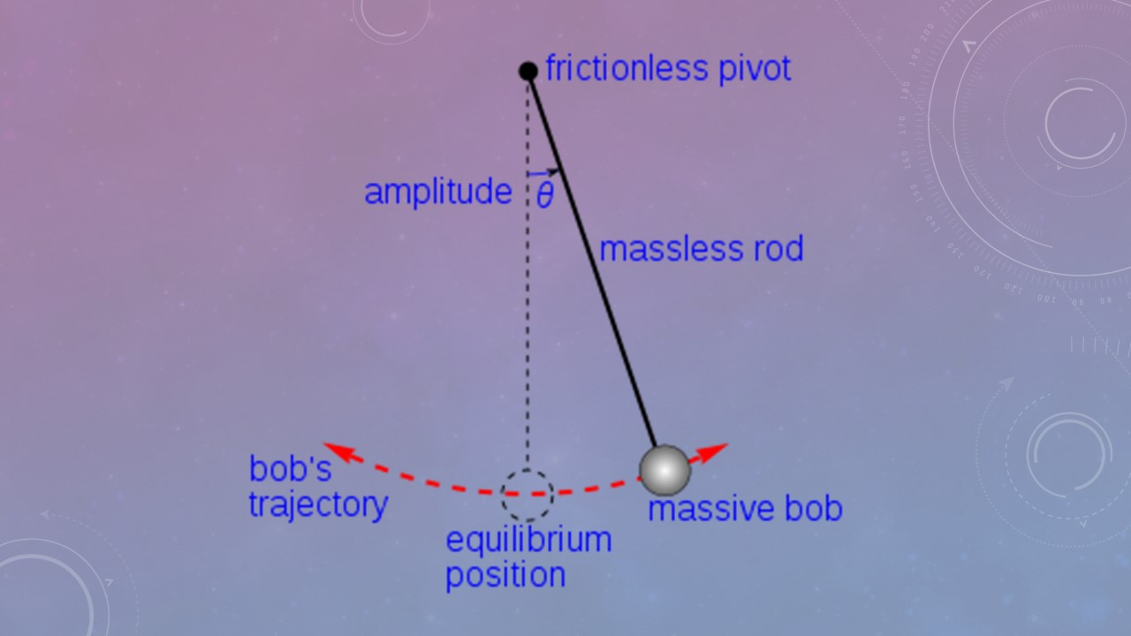

Slide 8
Caleb and the spies
Numbers 13: v 17 - 33
1. Be Strong and courageous
2. Be faithful
3. Be obedient

