Slide 2
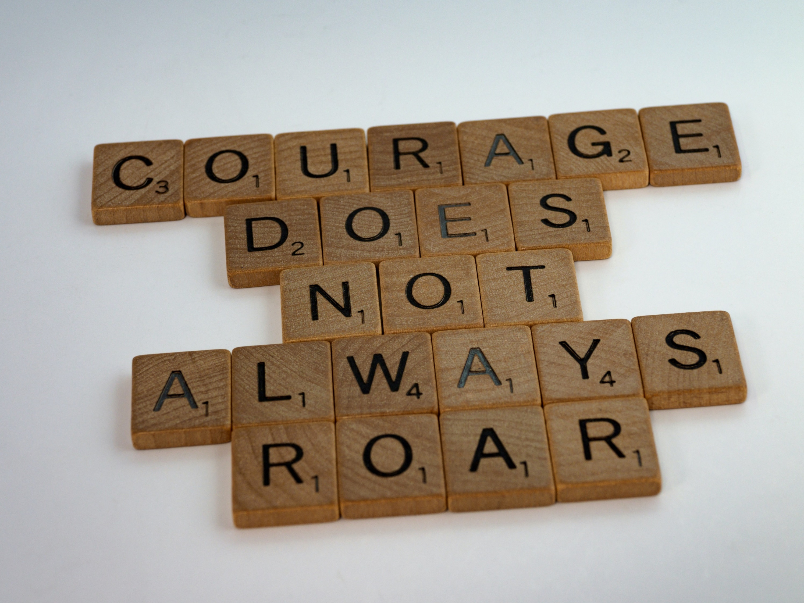
Image from Unsplash

Slide 3
Courage is not the towering oak that sees storms come and go; it is the fragile blossom that opens in the snow.
Alice Mackenzie Swaim
Image from Unsplash

Slide 4
Courage may not be our first response to trouble.
Image from Unsplash

Slide 5
Courage is not the absence of fear … it is taking our fear to God in prayer and saying let your will be done Lord
Image from Unsplash

Slide 6
'I must ask myself the question, ‘Can I thank God for trusting me with this experience, even if He never tells me why?’
Image from Urbana Student Mission Conference

Slide 7
What are you needing courage for today?
Image from Unsplash

Slide 8
Image from Unsplash

Slide 9
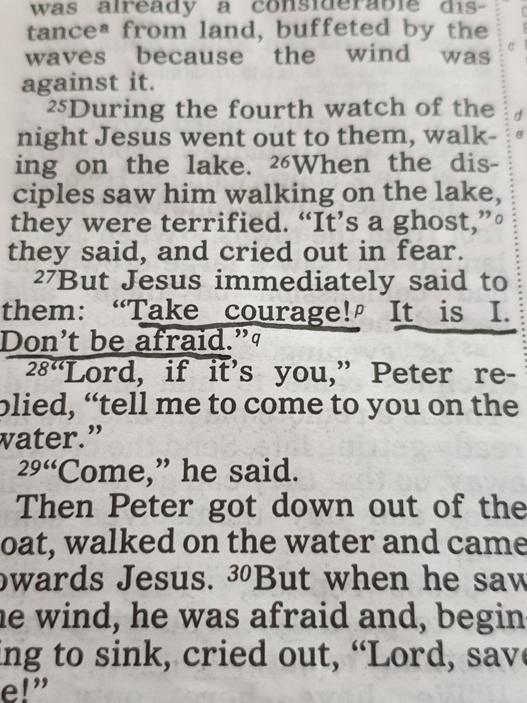
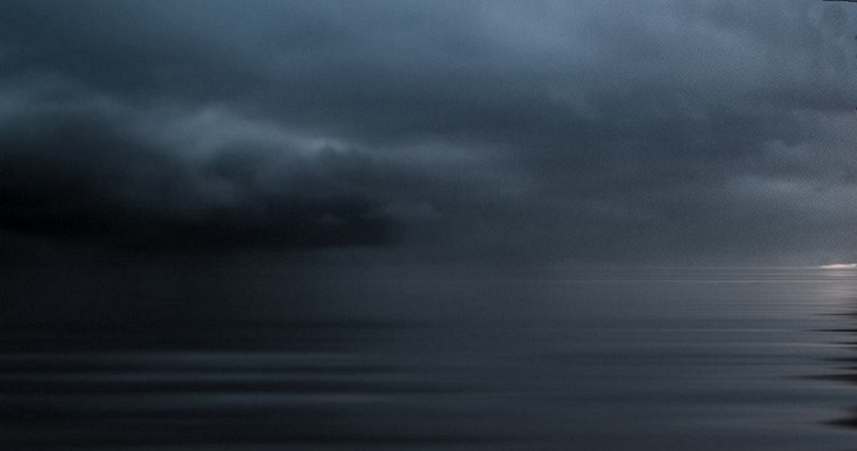

Slide 10
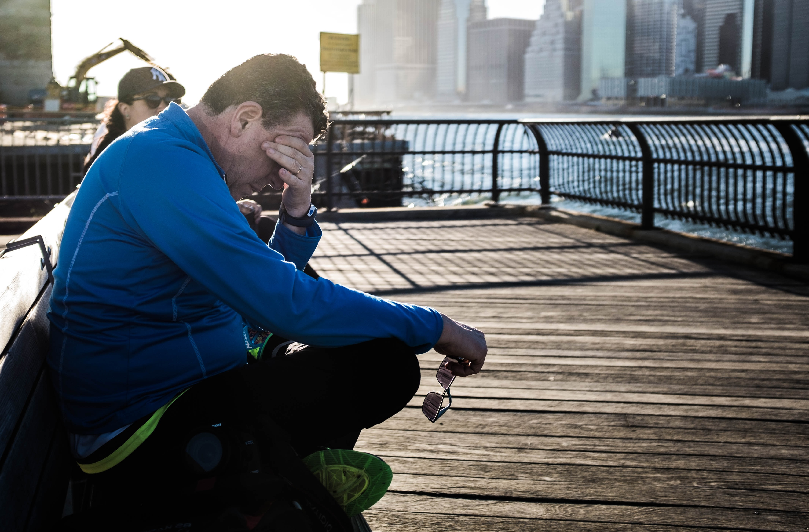
Courage to ask for help
Image from 1st News
Image from Unsplash

Slide 11
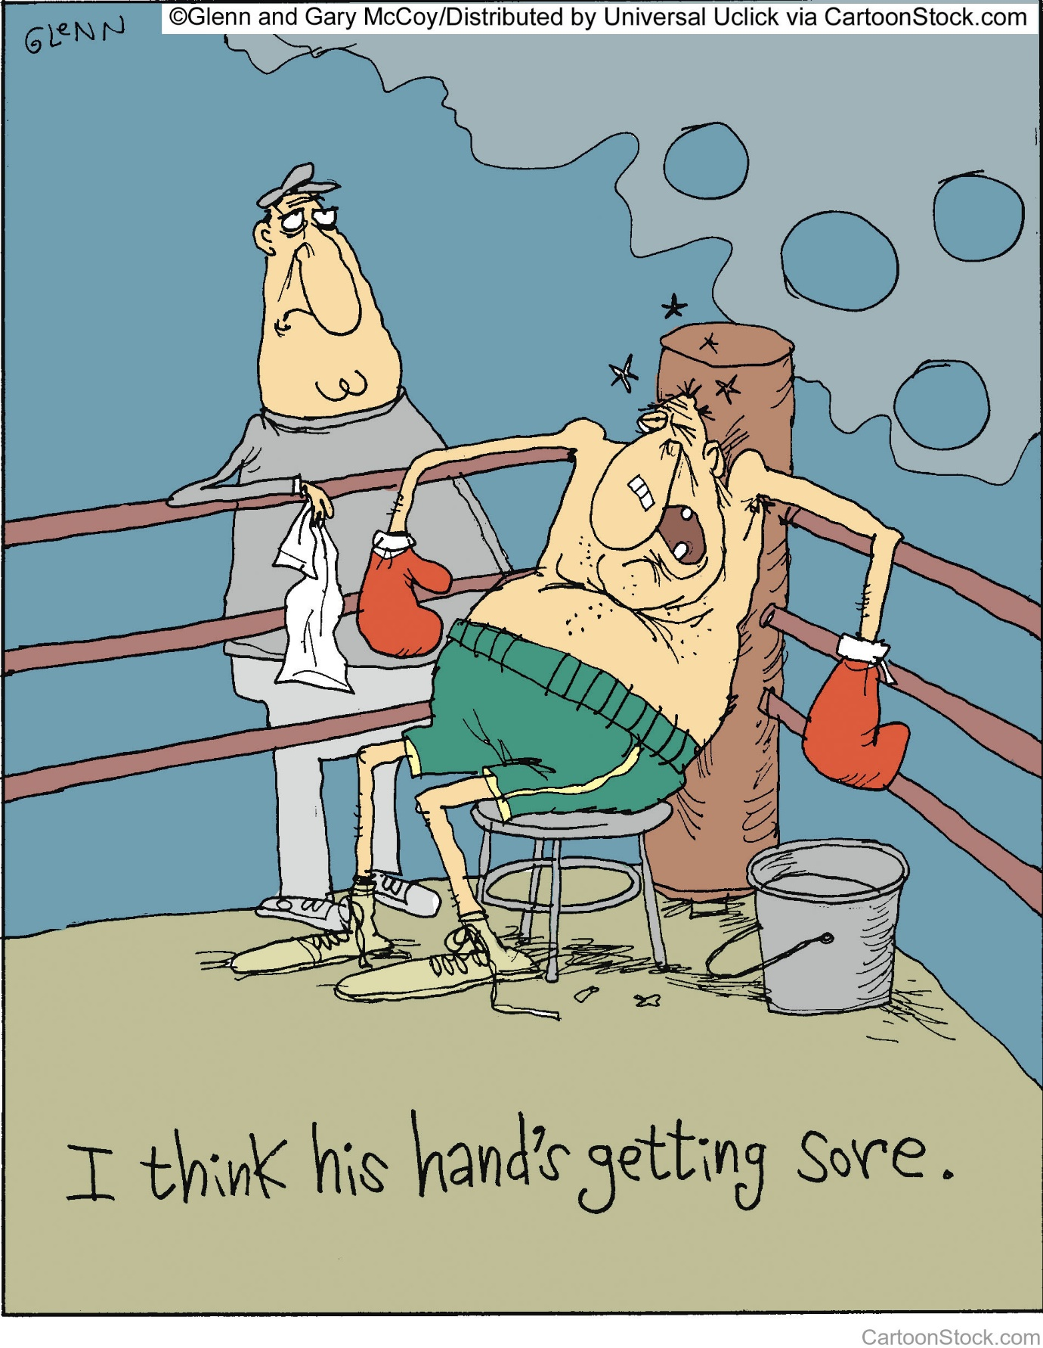

Slide 12
Image from 1st News
Image from Unsplash

Slide 13
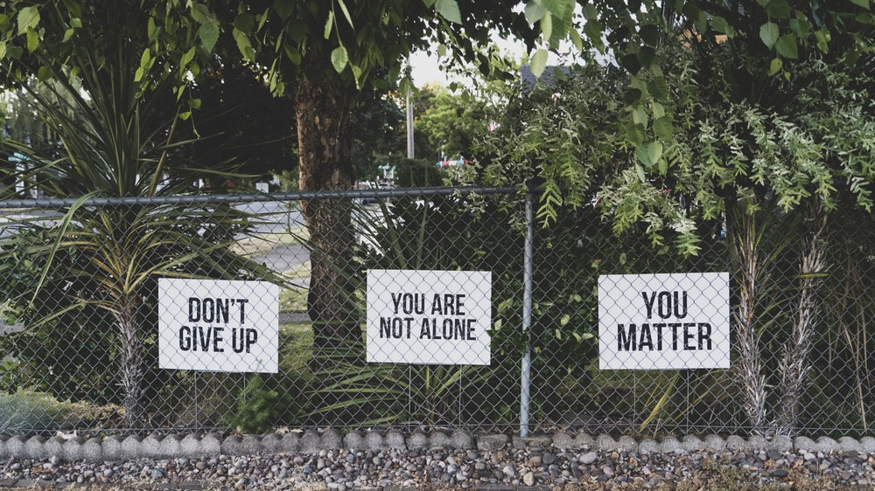
Image from Unsplash

