Slide 1
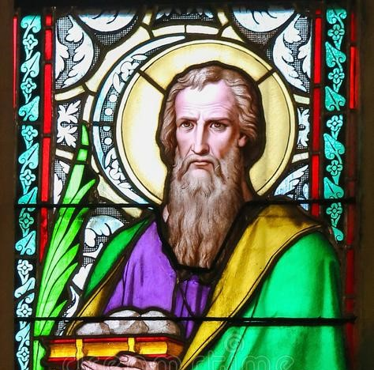
Barnabas : Son of Encouragement
ACTS : 11:19-30

Slide 2
Barnabas: full of the Holy Spirit and Faith

Slide 3
Barnabas: Generous and Giving

Slide 4
Barnabas : Integrity

Slide 5
Barnabas: Encourager

Slide 6
Barnabas: Discernment

Slide 7
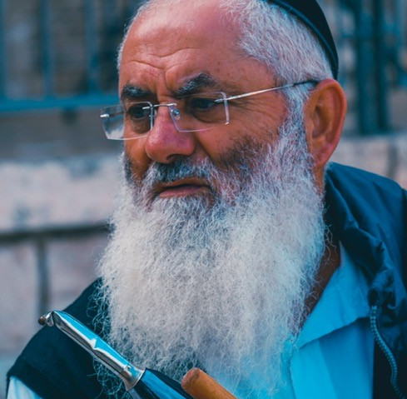
Barnabas: Teacher

Slide 8
Barnabas: - Full of the Holy Spirit -Generous and giving -Man of integrity -Encourager -Man of discernment -Teacher

