Slide 1
Image from Unsplash

Slide 2
Image from Unsplash

Slide 7
15 If it is burned up, he will suffer loss; he himself will be saved, but only as one escaping through the flames.
Image from Unsplash

Slide 8
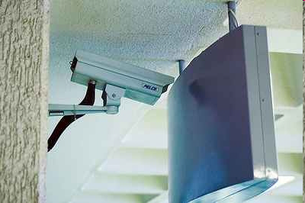

Slide 9
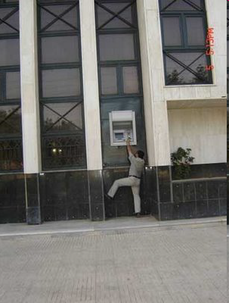

Slide 10
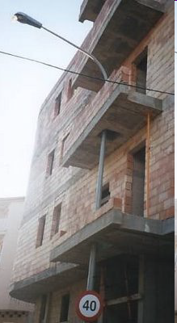

Slide 11
