Slide 1
Images from Unsplash

Slide 9
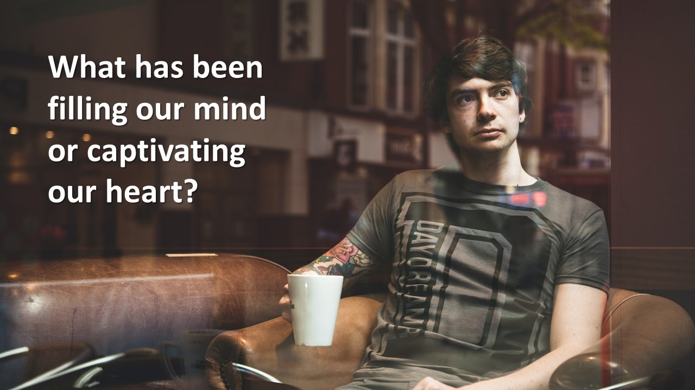

Slide 21
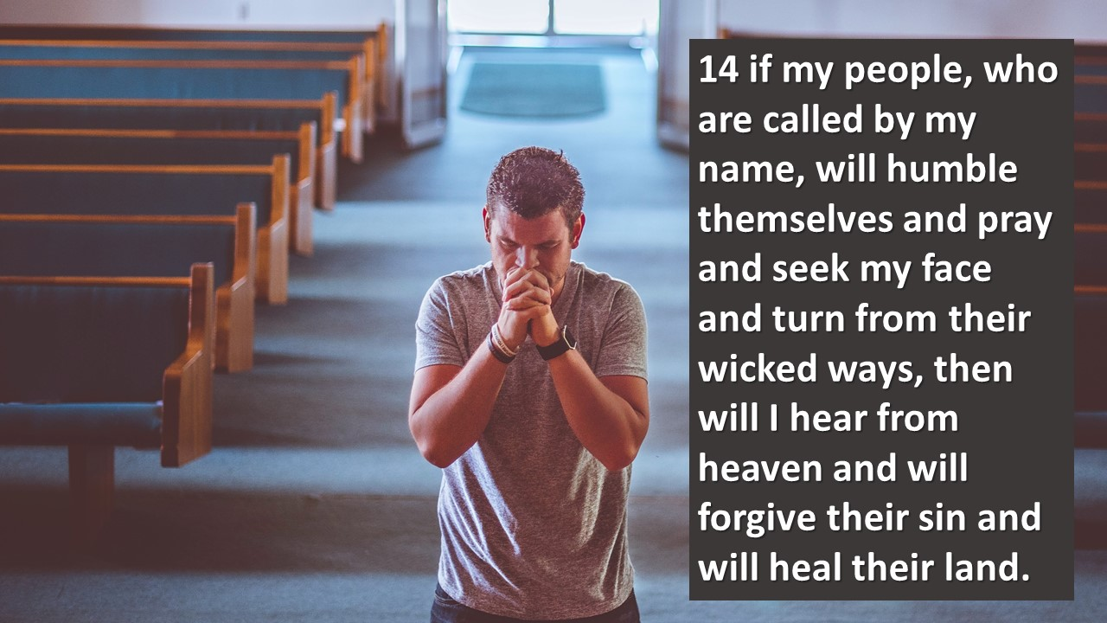

Slide 22
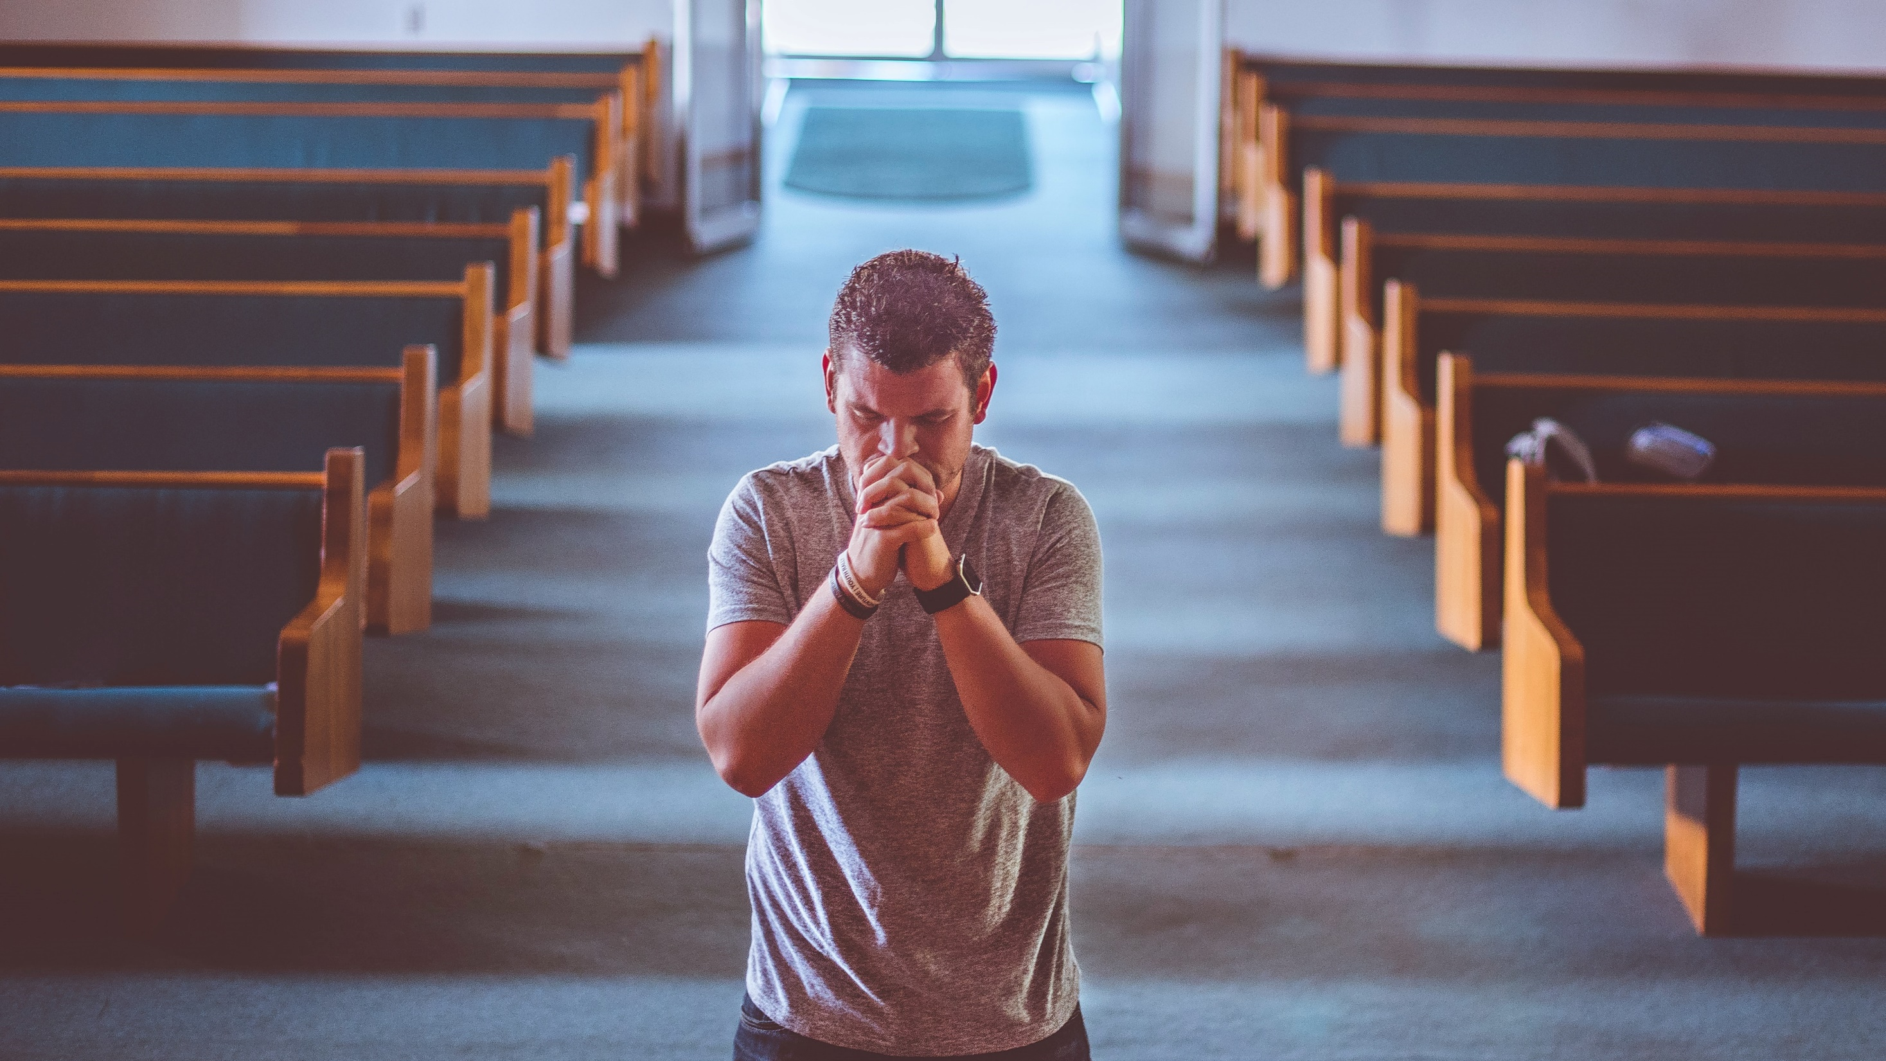
Humble themselves
Pray
Seek my face
Turn from their wicked ways

