Slide 1

Images from Unsplash

Slide 2


Slide 3
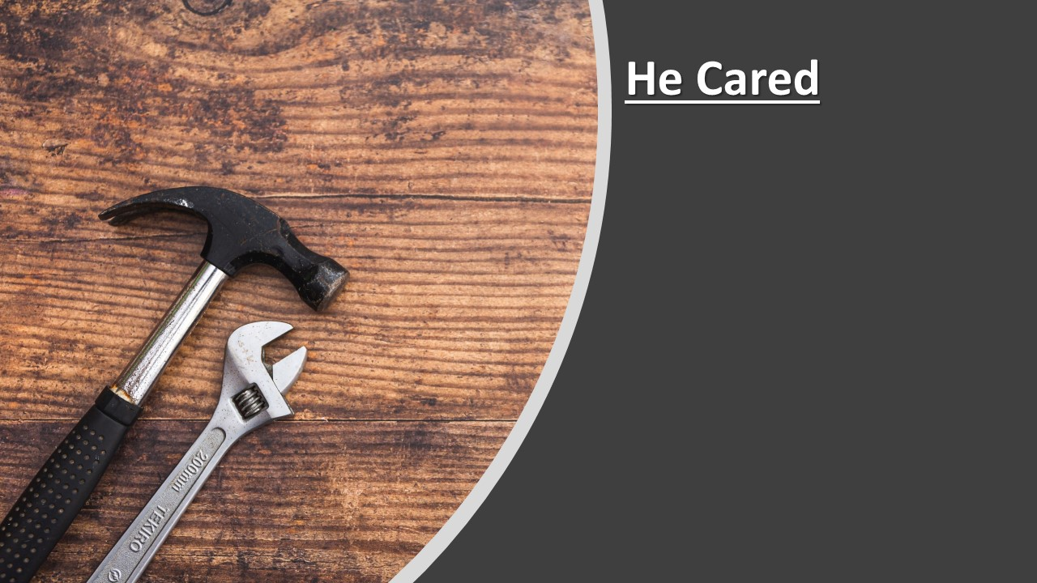

Slide 4


Slide 5
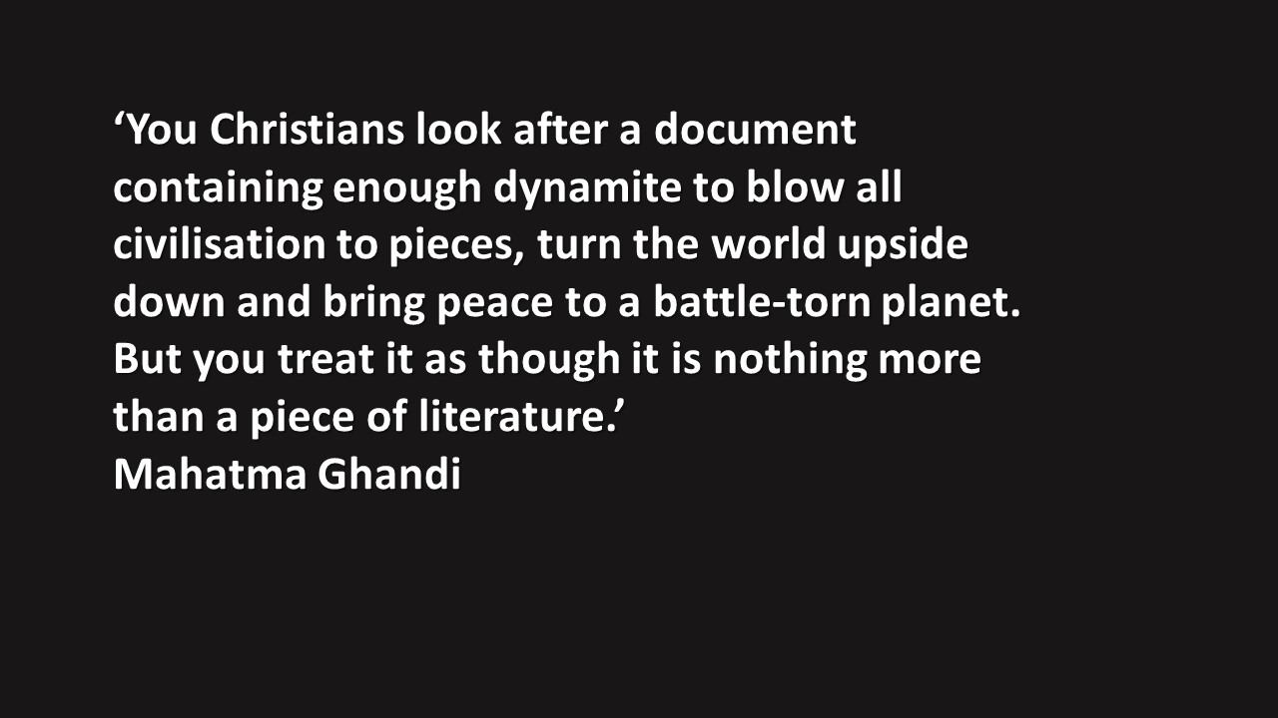

Slide 6
