Slide 1
Holy Spirit
The Great Comforter
Romans 8:1-17

Slide 2
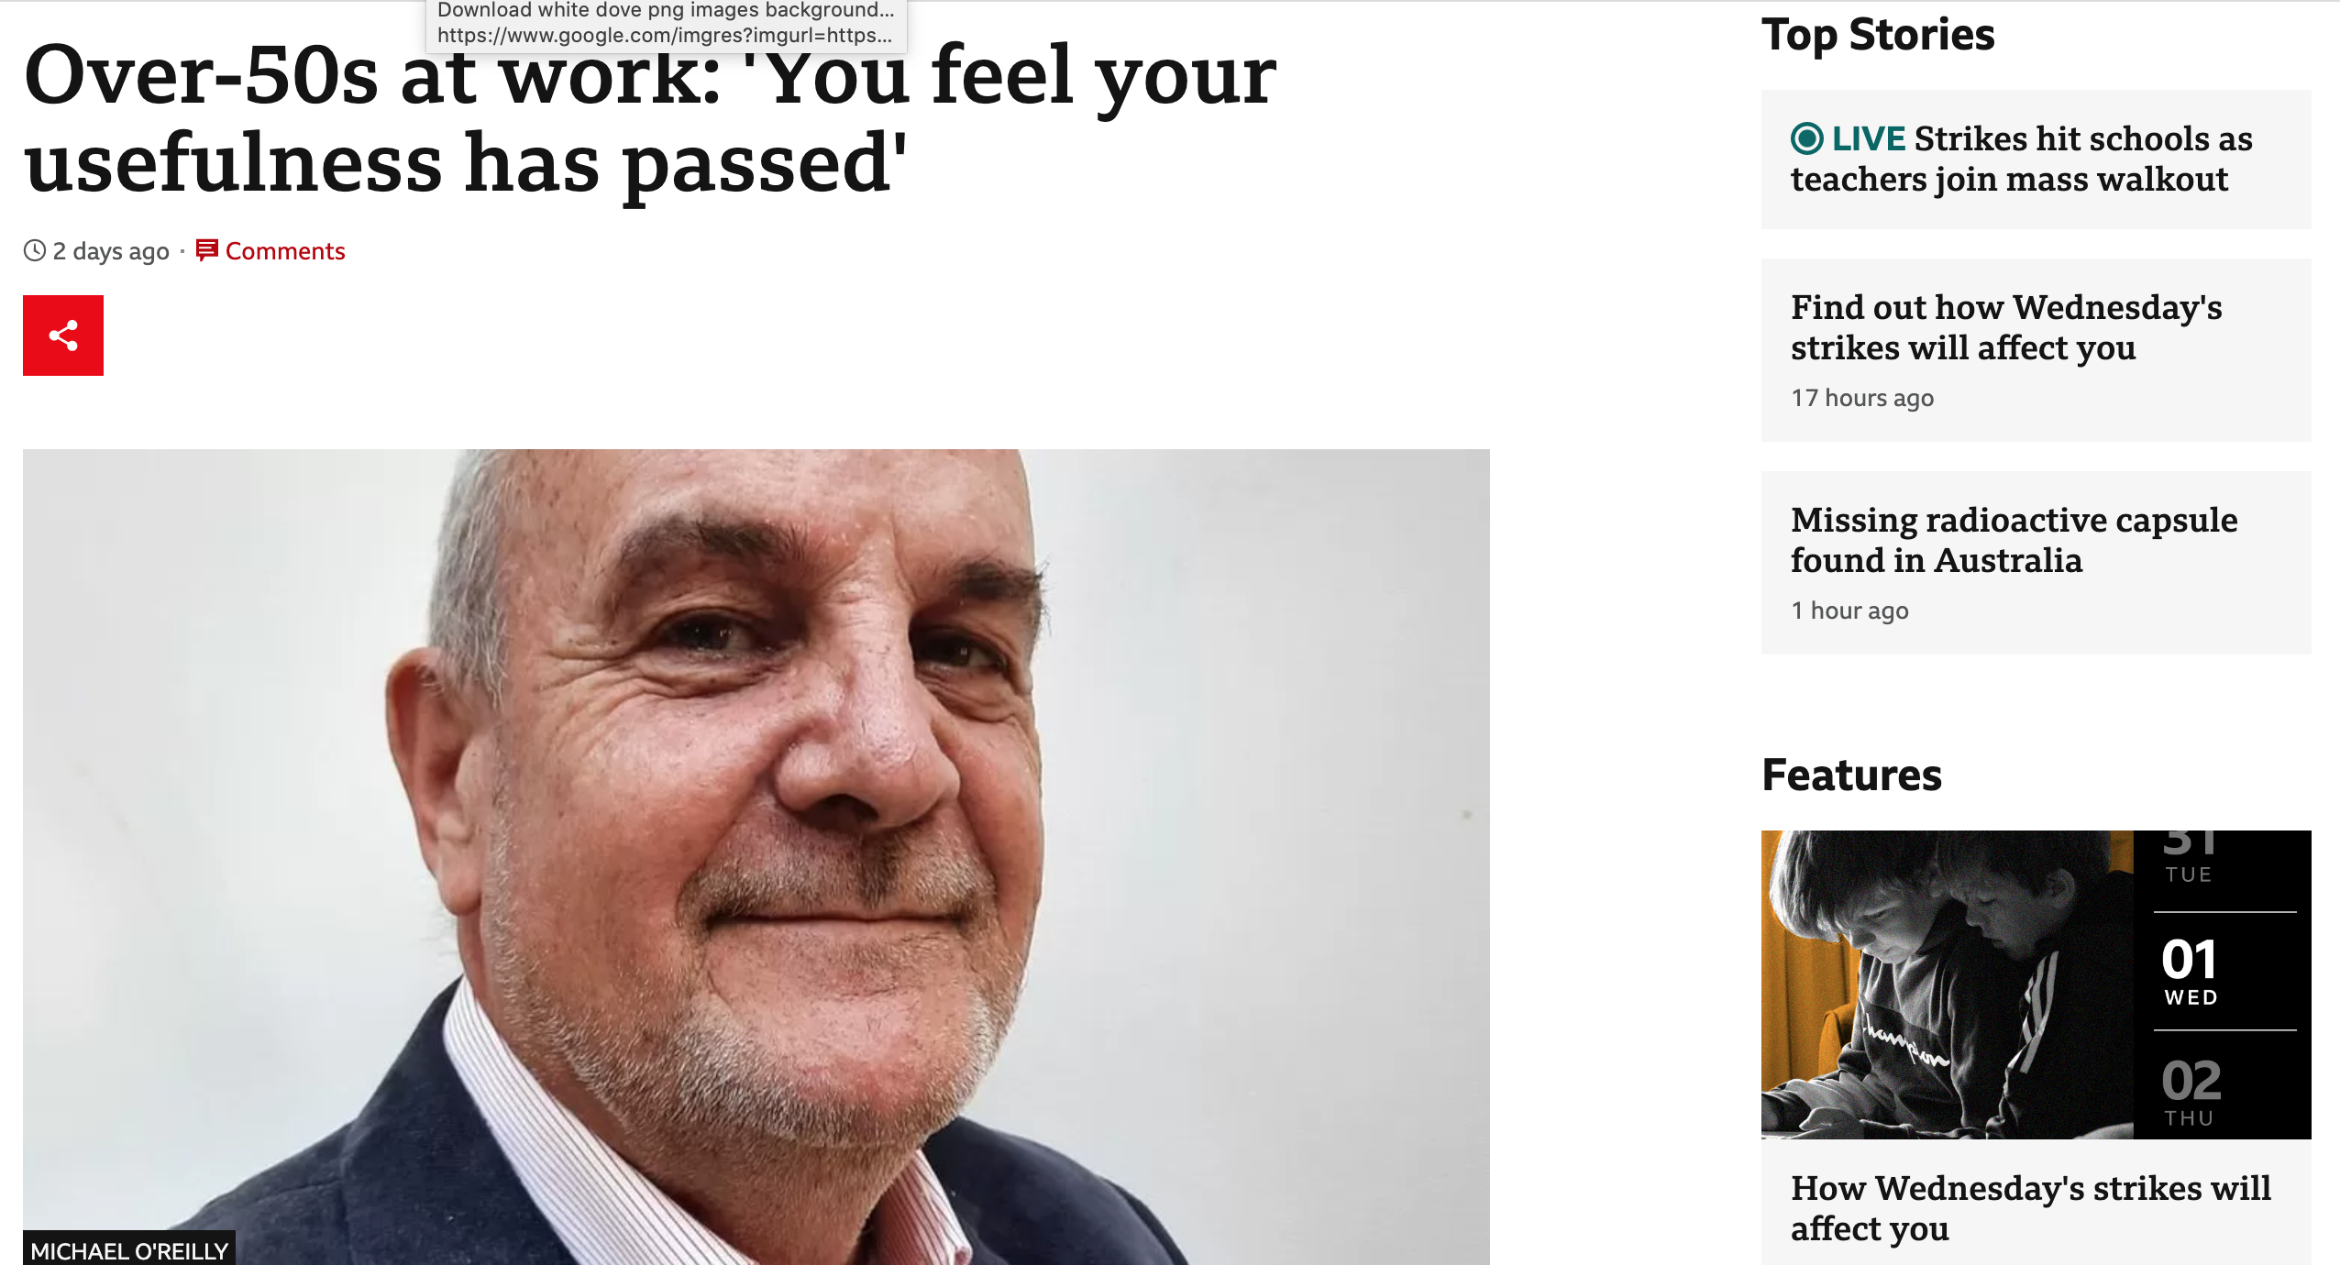

Slide 3
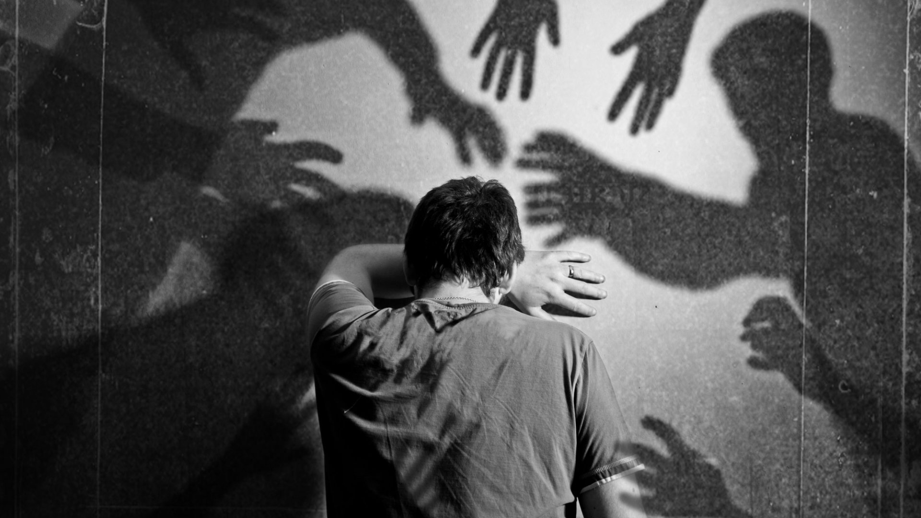

Slide 5
TRUTH

Slide 6
YOU ARE FREE
As far as the east is from the west, so far has he removed our transgressions from us.
Ps 103
So if the Son sets you free, you will be free indeed. John 8:36

Slide 8
YOU ARE FREE
And I pray that you, being rooted and established in love, 18 may have power, together with all the Lord’s holy people, to grasp how wide and long and high and deep is the love of Christ, 19 and to know this love that surpasses knowledge—that you may be filled to the measure of all the fullness of God. Eph 3:18

Slide 9
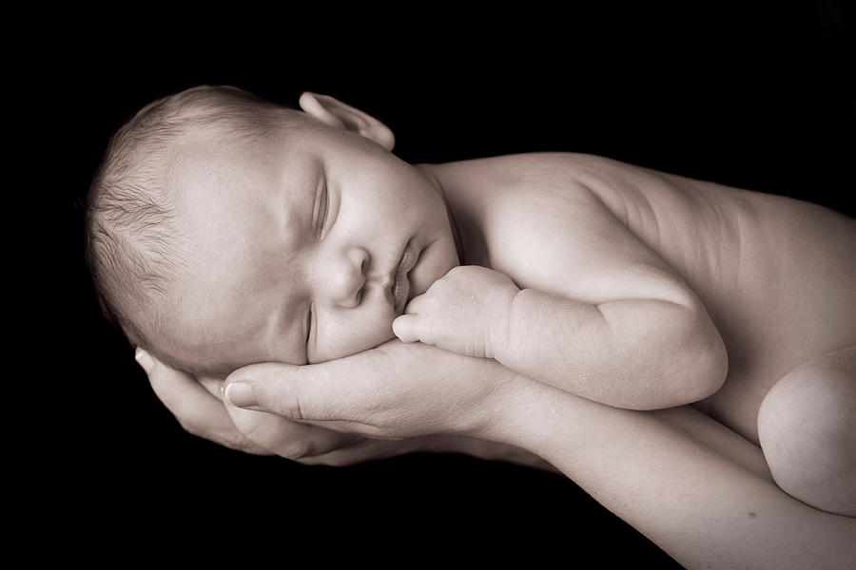
YOU BELONG TO GOD

Slide 10
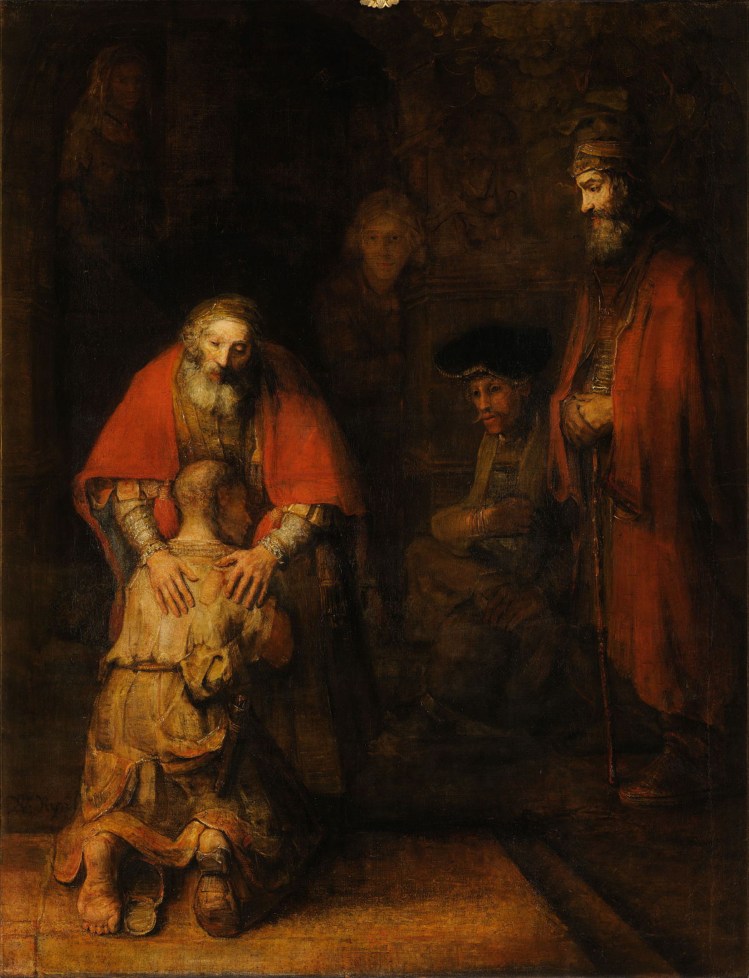
THE ROBE
THE RING
THE SANDALS

Slide 11
YOU ARE AN HEIR
Now if we are children, then we are heirs—heirs of God and co-heirs with Christ

