Slide 1


Slide 2
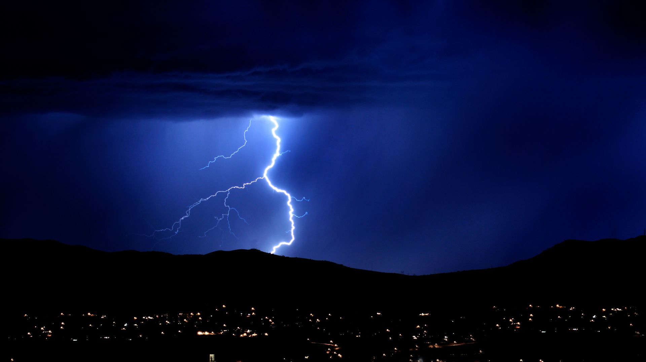
God is still in control

